Slide 1
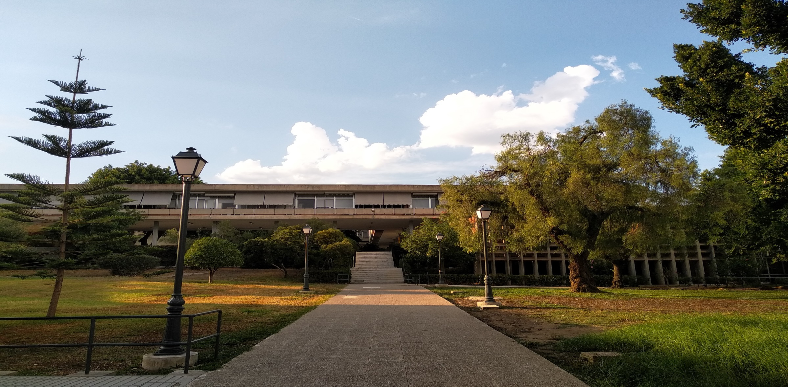
IES Num 1 UNIVERSIDAD LABORAL DE MÁLAGA (SPAIN)
IES Num 1 Universidad Laboral de Málaga is one of the biggest high schools and vocational training schools of Andalucía. Currently it serves over 2.000 students and has 200 teachers who are allocated among the following levels: secondary school, baccalaureate, and six differents vocational trainings lines. It has a student residence, multiple sports facilities, wonderful tropical gardens, and high-level equipment and infrastructure to offer the vocational training cycles of the different branches
The coordination of the project at the center will be carried out by Beatriz Toscano Gil, Engineer in Agronomic Sciencies, Coordinator of the Erasmus Department of Vocational Training and Teacher of the Agricultural cycle

Slide 2
The branches of the Universidad Laboral who will participate in the Sustainable Salon project will be the Departments of Chemistry and Agrarian
Advanced Vocational Training courses of Agrarian and Environmental:
Environmental Education and Control
Advanced Vocational Training courses of Chemistry:
Environmental Chemistry
Quality Analysis and Control Laboratory
Manufacture of Pharmaceutical, Biotechnological and Related Products

Slide 3
Objetives set for Universidad Laboral
O1: Profiles/competences of the hairdresser in 2030
SECTION 1. Surveys and information about the sector. Sustainability.
SECTION 2. Year 2020. Demands and Competences/profiles/skills in the sector. Sustainability.
Local tools and good practices for environmental protection, sustainability.
Attitude of national producers/suppliers.
SECTION 3. Year 2030. Trends, future demands/skills. Sustainability.
O2: Sustainability standard for the schools and the sector

Slide 4
Next goals to be achieved by february 2021
O2: Sustainability standard for the schools and the sector
Work in the environmental aspects per work station (shampoing, hair cutting, dying, perms, ..) and management: energy, water, equipment, waste, ventilation, ingredients, etc.
Legal requeriments per environmental aspects regarding use
Establish standards per environmental aspects including the level bronze, silver, gold

Slide 5
Work team of Universidad Laboral de Málaga

Slide 6
Dissemination of the project
Director of the Universidad Laboral and Paloma, Malaga’s Coordinator. Publication in DiarioSur newspaper. https://www.diariosur.es/malaga-capital/malaga-ue-proyecto-erasmus-busca-sostenibilidad-salones-belleza-20210902112553-nt.html. Publication in the Universidad Laboral’s web https://sites.google.com/unilabma.com/erasmus-unimalaga/sustainable-salon

