Slide 2
ENERGY IN THE HAIRDRESSING SALON II Module 3

Slide 3
Legislation.
-The 2015 Paris Agreement,
- United Nations Framework Convention on Climate Change 2018 and
-The 2030 Agenda for Sustainable Development
-The European Green Deal of 2019.
-Regulation (EU) 2019/943 and .
- Directive (EU) 2019/944 of the European Parliament and of the Council of 5 June 2019 concerning common rules for the internal market in electricity
-Regulation on Thermal Installations in Buildings (RITE)
-Law 7/2021 of 20 May on climate change and energy transition.
- Royal Decree-Law 14/2022, of 1 August, on energy saving and efficiency measures and the reduction of energy dependence on natural gas.

Slide 4
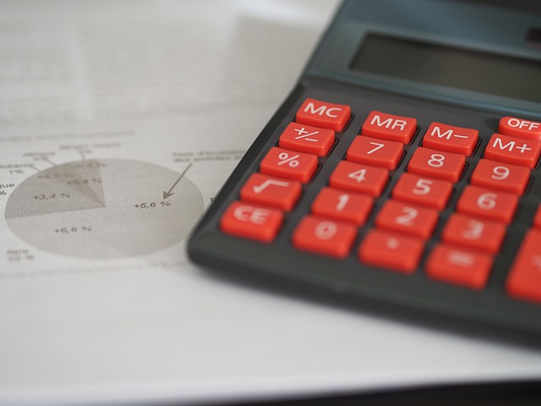
Calculate energy consumption.

Slide 5
Example 1:
Step 1 | If there are nine bulbs in a room and each bulb is 100W, the total wattage consumption of the lights can be found by multiplying the number of lights by the watts they consume. Consumption in W (9 bulbs) = 9 x 100W = 900W
Step 2 | To find out the watts per hour, we need to know how long they are on for. Let's consider that they are on for 9 hours. 900W x 8h = 7,200 Wh
Step 3 | Now, to determine how many megawatt hours this is, as this is the variable that appears on electricity bills, we divide the number of watt hours by 1,000,000. 7,200Wh÷ 1,000,000 = 0.0072MWh

Slide 6
Example 1:
Step 1 | We calculate: the lights are generally on for eight hours each day five days a week and on Saturday only for 4 hours: (8h/day x 5) + 4h = 44 hours/week
Step 2 | If we consider that about 40 weeks a year are worked, we have: 44h/s x 40 = 1,760 h/year
Step 3 | Finally, to know the energy consumed in a year, we must multiply power x hours per year: 0.0072 MWh x 1,760 h/year = 12.672 MWh/year
Step 1 | 12.672 MWh/year x €85.80 = €1,087.3 annual expenditure for the hairdressing salon bulbs alone.

Slide 7
Consumption calculator

Slide 8
Digitalization for savings.

Slide 9
Innovation and y efficiency to reduce consumption.
Anti-heat or anti-cold window films.
Thermal insulation windows.
Energy Star labelled IT equipment.
Reduce water consumption.
Hire a Company specialized in energy consultancy.
Thermal and/or photovoltaic solar panels.
Eficcient wáter heating.
Wind generators.
Change premises!

Slide 10
Cost of investments.

