Slide 1
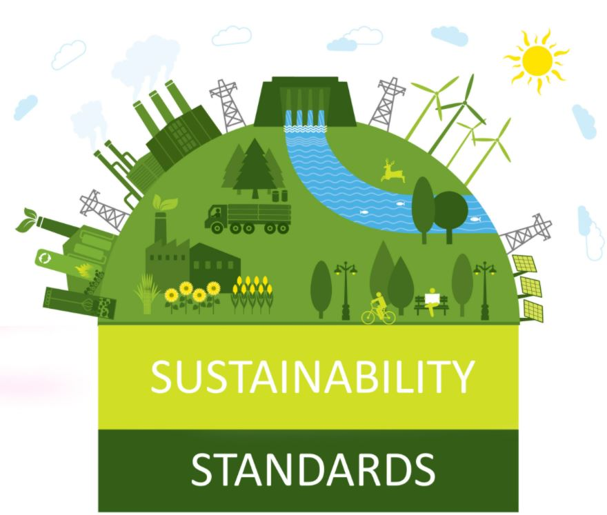
Certification of a sustainable salon
Notes:
Welcome to our online presentation.
Stivako asked us to give a short introduction about certification and how certification standards are developed.
My collegue (Rand) and I wil try to explain this in the next 30 minutes and at the end we will give you a first assignment which you can use in your project
But first let us introduce ourself

Slide 2
Subjects to be discussed
Why certification?
Involved parties and different roles within certification
Accreditation vs no accreditation
Types of certification proces
Development of a certification scheme
Notes:
We will send the presentation to you inculding a informationdocument about these subject.
I will give you more information about certification, involved parties, accreditation and explain the different possibilities of certification and specific for small and practical companies like hairdressers
Rand will talk you throug

Slide 3
Why certification
(Sustainable) certification gives your company:
a unique selling point
a good and sustainable image
one step ahead (better control on the organization)
saves money (insurance, less waste, better purchase etc)
Most companies with certificates:
Have a higher financial return
Higher customer satisfaction
Be seen as more reliable
Notes:
USP: promote your certification and the goals you have reached by continious improvements
One step ahead: of your competitors
Sustainable image: think about the future and a sustainable business
Saves money: beceause you are more aware of using less energy and less water
Research shows that companies with certificates

Slide 4
Involved parties
ACCREDITATION
BODY
CERTIFICATION ORGANIZATION
CONSULTANT
SALON
Developing and monitoring standard
Auditing
Advise and support
Works according to established procedures
Notes:
Standard Setting Body: Development of (world wide) standards
Certification institue: Auditing and certifying standards. the actual assessment of a company whether it meets the standard and passes certification
Advisor: Independant advice to support a company throught the certification proces
Salon (or company) thats wants to obtain a certificate

Slide 5
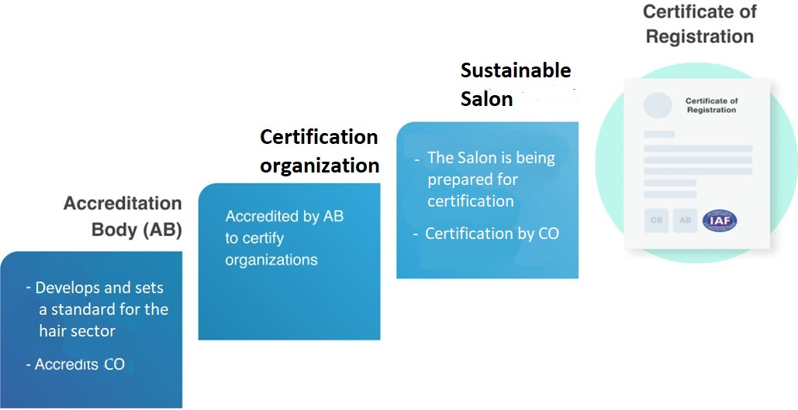
Certification proces
Notes:
Accreditation means that the Certification institute or a specific certificate is under control of an extra 3rd and independent party, the accreditation board.

Slide 6
Accreditation
Accreditation is not obligated
Small certification body’s or sector specific certifications are mostly not accreditated
A supervisory board can replace this and still have the reliability as an recognized certification body
This saves high accreditation costs and customized certification is possible
Notes:
For small certification institutes or sector specific certification scheme’s accreditation is not applicable because of the high costs and the extra time it takes to comply to accreditation. Small certification institutes can use a own supervisory board as an 3rd and independent party.
So for salons, don’t worry about accreditation, beceause that is not necessary. Accreditation will make it to complicated and expensive for a business like hair salons.

Slide 7
Types of certification
Regular
(Individual)
Group
Notes:
The are roughly 2 types of certification.
Regular for everybody
Group for small companies
Let me explain the differences

Slide 8
Regular certification
AUDIT FORM
Auditing
Advice
Consultant
Notes:
Here you see the different parties within certification:
The standard setting body, for developing a standard
The certification institue for the assesments or auditing
The salons
The consultancy companies for advice

Slide 9
AUDIT FORM
Group
certification
Sample auditing by the ecertification
organization
(√ number of groupmembers)
Group-manager
Annual advice and internal audit
Annual advice and internal audit
SALONS 1, 2, 3, …
Notes:
A groupmanager is responsible for the whole group.
The group manager fulfills an annual internal audit and may support and advise group members as in-house adviser.
The groupmanager is in fact a collegue of the company
The certification body applies only a sample audit of the group. The larger the group, the less audits in relation to the total amount of groupmembers.
Important to know: Group in Groupcertification means a group of individual small salons. It is not about an existing coorperation or franchise-formula

Slide 10
Group certification
Groupcertification is developed for small companies (<25 employees)
The groupmanager is your central contactperson for advise and your certification
Prefab bleuprint material can be used
Cheaper for consultant and certification
It makes certification feasible for small companies like salons
‘Group’ in Groupcertification means a group of individual small salons
Notes:
For so far my explenation about certification, the different parties and possibilities of group certifications.
Know Rand will talk you throught the development of a standard.

Slide 11
Levels of certification
Plus Gold
Regular Silver
Basic Bronze
Notes:
We propose the following levels of certification: Basic, regular and plus which we can identify as Bronze, Silver and Gold.
By stimulating to start, the first step will be the basic level to get introduced to the system. Within this level you can reach basic criteria to achieve improvement in environmental issues. The basic level is similar to an entry level and achievable for starting.
Companies will be stimulated to develop and grow to next level which is the regular level. And if you have the ambition to work at the top in the field of sustainable entrepreneurship, than go further for Plus level.
This concept of certification we had successfully tested and brought in practices in the Netherlands within the creative industry with many positive experience. Experience of this certification schemes was on Health and safety but also on Energy Management system. This concept can be successful in Salons.

Slide 12
Development process
1.
Standard criteria
2.
Methodology
3.
Knowledge
4.
Marketing
Notes:
The development process will contain a couple steps to achieve a certification system which I will explain in more details now.

Slide 13
Development process
1.
Standard criteria
Requirements for Sustainable salon
Notes:
First we will start with the development of the standard criteria.
This means defining the minimum criteria to achieve the level of sustainable salon.
Those criteria will be developed with the project team members and experience partners of salons.
The condition within the certification system is to develop one in condition to be practical and applicable for salons.
To start with this step we have an assessment included which I will explain at the end.

Slide 14
Development process
2.
Methodology
Review methodology
Notes:
Next step is to define the review methodology.
That means in which way we can review if the salon meets the standard criteria and is in line with environmental issues.
The conditions which the review process will be taken:
online tool, or
automatic review, or
checklist, or
illustration minded
Setting the bar. When is a company passing and when is it failing for each certification level

Slide 15
Development process
3.
Knowledge
knowledge and materials
Notes:
The next step is to gather knowledge and develop materials to be used by salons and make the implementation step low threshold.
The standard criteria will be worked out in practical solutions for the salon and will be the roadmap to achieve chosen level.
- Developing an online softwaretool (Risk Analysing tool)
- Developing an application
- Developing simple Word- or Excel blueprint material
This concept is also been used in the Netherland for different certifications themes and turns out successful.

Slide 16
Development process
4.
Marketing
Selling point
Notes:
Finally the Marketing step.
As my college explains the needs for certification, in this step we will focus on the unique selling point and develop instruments for marketing your certification.
We suggest to develop different communication instrument like logo, wall board, news articles, etc. to help salons promote there sustainable policy.

Slide 17
Sustainable salon
Planet
‘The salon complies with the minimum environmental aspects and avoids risks of damage to the environment’
Notes:
First we should define the starting position of "Sustainable Salon".
This definition must be clear before the next step can be taken.

Slide 18
Workstations
Shampooing
Management
Cutting
Dyeing
Perms
Styling
Nails
Notes:
In this slide, we show the workstations which are defined for salon.
These workstations we will use for the assignment which I will explain now.

Slide 19
Future steps
Planet: ‘The salon complies with the minimum environmental aspects and avoids risks of damage to the environment’
Profit: ‘The hair salon meets the minimum quality aspects and avoids risks in terms of customer satisfaction and continuity’
People:
‘The hair salon complies with minimum health and safety aspects and prevents health and safety risks’
Notes:
For the future it is also possible to develop next steps for green salon to achieve quality and health and safety standards and stand out as corporate social responsible salon.

Slide 20
Questions?
Notes:
We would like to thank you for your attention and if there are any questions please let us know.

