Slide 2
ENERGY AND SUSTAINABILITY Module 1

Slide 3
Energy, general concept.
Energy is the ability of matter to do work because of its constitution (internal energy), its position (potential energy), its temperature (thermal energy) or its motion (kinetic or mechanical energy), etc.

Slide 4
Basic propierties of energy
It transforms.
It is conserved.
It is transferred or transported.
It degrades.
energy is neither created nor destroyed, it is only transformed into another type of energy.

Slide 5
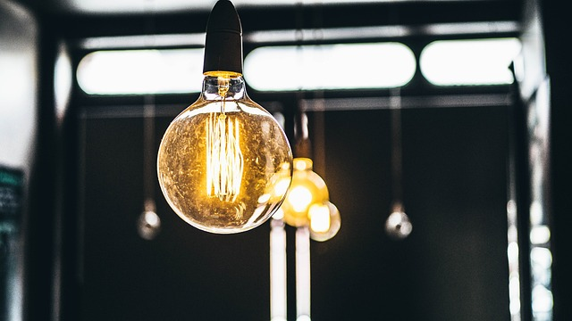
Types of energy.

Slide 6
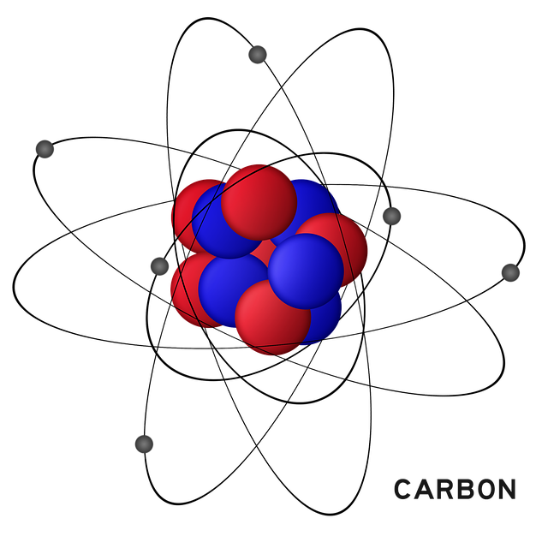
Electrical energy.

Slide 7
Electricity production
Power generation.
Power transmission.
Energy distribution.
Energy commercialization.

Slide 8
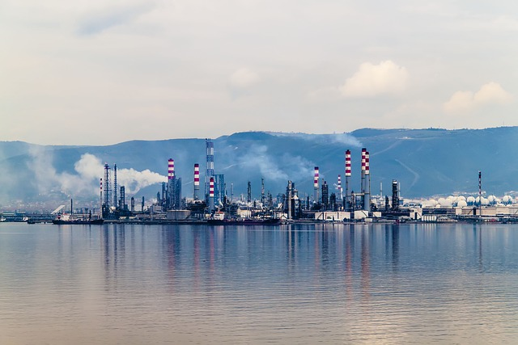
Energy sources.

Slide 9
Energy sources:
Renewable

Slide 10
Energy sources:
Renewable

Slide 11
Energy sources:
NON-renewables

Slide 12
Nuclear energy

Slide 13
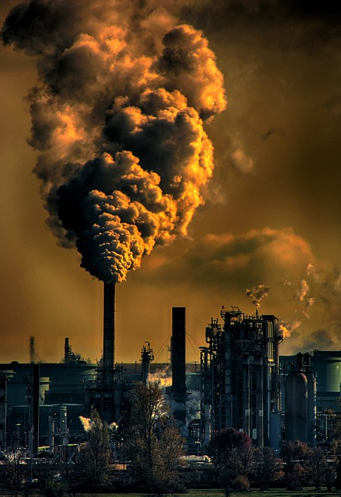
Environmental impact of energy.

Slide 14
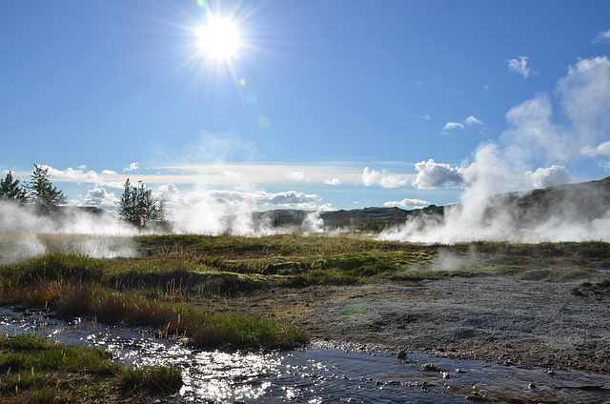
Clean energy

Slide 15
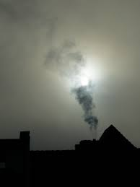
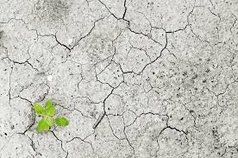
Effects on the environment

Slide 16
Continue learning with
Level 2 didactic unit:
"Energy in the Hairdressing Salon I".

