Slide 1
Module 3 Legislation around waste and setting up a low-waste salon
Management level students' class

Slide 2
Index
Legislation (rules and laws) about waste in your country / region
Why is it important to know the rules and laws?
How do you set up a low-waste salon
Recap: what have you learned?

Slide 3
Assignment: Legislation about waste in your country / region
Short research on legislation concerning waste in the country: WORK IN PAIRS / SMALL GROUPS What are the rules and laws (legislation) about waste in your country? Where can you find the information? Study the websites of the (local) government / authorities on this subject. Is it clear what rules do hairdressers / salon owners have to follow? Is there a professional association that can help professionals or entrepreneurs with this kind of issues? What is the name of this association in your country? Where else can you go for advice?
Image by rawpixel.com on Freepik

Slide 4
Legislation (rules and laws) about waste in your country / region
Answer to the assignment:
Apparently, situation with legislation is complex. There is no definite laws or very clear rules hairdresser salon owners need to follow.
There are general rules though like the maximum allowable weight percentage of waste generated by activity, as well as the minimum recycling weight percentage required for industrial activities, often regulated by local policies, which apply to all businesses

Slide 5
Why is it important to know the rules and laws?
You are planning to become a hairdressing salon manager / owner in the future (if not, imagine that you are!)
Think about:
Why is it important for a business owner to be aware of the rules and legislation? If he/she has no personnel? If he/she also employs people?
What are the possible negative consequences of not knowing or following the rules?

Slide 6
Optional: giving waste-efficiency advice
WORK INDIVIDUALLY
Do a little research or use your previous knowledge (for instance, from the Module 2 of the Students’ Manual) about proper waste management at a salon.
Write down 3 to 5 tips of advice for a starting hairdresser entrepreneur concerning the efficient waste-management. Think of innovative products or product alternatives that are less damaging for the environment (e.g. Paper Not Foil etc.)

Slide 7
Smart waste-management as part of a business plan for your Dream Salon
Imagine you are writing a business plan for setting up a Dream Salon
In what simple steps can you set up a low-waste salon?
Write down the steps of your plan
Remember: only the most sustainable business plan will be granted a financing and you really need the money for your dream enterprise!
Describe how you are going to get your whole team on board being motivated to follow this plan? What kind of incentives are you going to use?
How can you use your waste management plan in your employment process?

Slide 8
Recap – what have you learned?
Whether or not there is explicit legislation about waste in your country or region which applies to a hairdresser businesses
Why it is important for a business owner to know the rules
Giving waste-efficiency advice to a salon owner
Smart waste management plan assignment

Slide 9
Corporate Social Responsibility and waste at a hairdresser salon
Management level students' class

Slide 10
Index
Corporate Social Responsibility (CRS)
CRS in relation to waste
How to apply waste-related CRS at a salon
Waste-related CSR as a marketing tool

Slide 11
Corporate Social Responsibility (CRS)
Corporate social responsibility (CSR) is a self-regulating business model that helps a company be socially accountable to itself, its stakeholders and the public. By practicing corporate social responsibility, also called corporate citizenship, companies can be conscious of the kind of impact they are having on all aspects of society, including economic, social and environmental.
To engage in CSR means that a company is operating in ways that enhance society and the environment instead of contributing negatively to them. CSR helps both improve various aspects of society as well as promote a positive brand image of companies, thus creating a win-win situation.
Image by rawpixel.com on Freepik

Slide 12
CRS in relation to waste and waste management
With some previous knowledge about 3R’s at a hairdressing salon, think of the following:
What CRS practiced in relation to waste reducing and recycling can be applied at a salon?
How can a salon manager / owner facilitate the use of these practices?
Can a salon manager / owner use incentives / renumeration system to motivate the employees to apply the waste-related CSR at a salon?

Slide 13
Water-related CSR as a marketing tool
Customers nowadays become more and more environmentally conscious!
If you are using (water-related) CSR in your salon, make sure to:
Promote these kind of practices in your marketing communication by:
Hanging around some posters that you save water
Adding a disclaimer on your website or social media that you are saving water / sorting waste / using green hair and scalp products
are awarded a quality mark or certification etc.

Slide 14
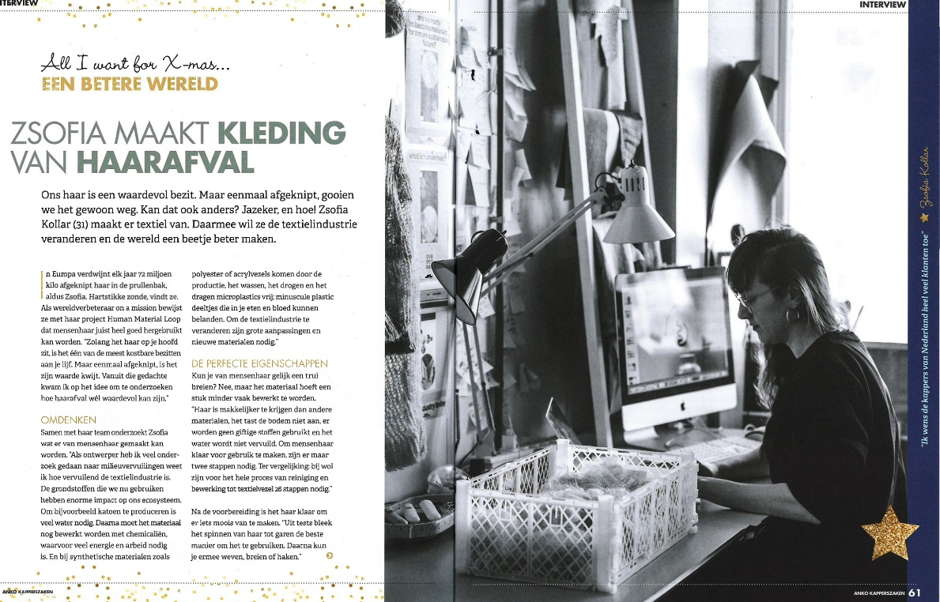
Hairdresser’s waste as new raw material
Zsofia is a young and innovative entrepreneur from the Netherlands and she’s trying something new out: textile and clothes made from human hair. According to Zsofia, you need 26 (chemical) manipulation steps to use the sheep wool for cloths, while it’s only 2 for human hair! Human hair has amazing qualities: it’s a limitless resource and it’s also antiallergic. The garments she makes are still in the experimental phase, but will soon be available on the market:
In 2 groups discuss:
Group 1 defends the PROS of the human hair clothes (win-win)
Group 2 is very sceptical and comes with the CONS as arguments

Slide 15
Recap – what have you learned?
What is CRS?
What is CRS in relation to waste and in the context of a hairdresser salon?
How do you motivate your team to follow your low-waste salon policy?
How and why your can use your waste-related CSR as a marketing tool?
Hairdressers’ waste as new raw material: TOP or FLOP?

