Slide 1
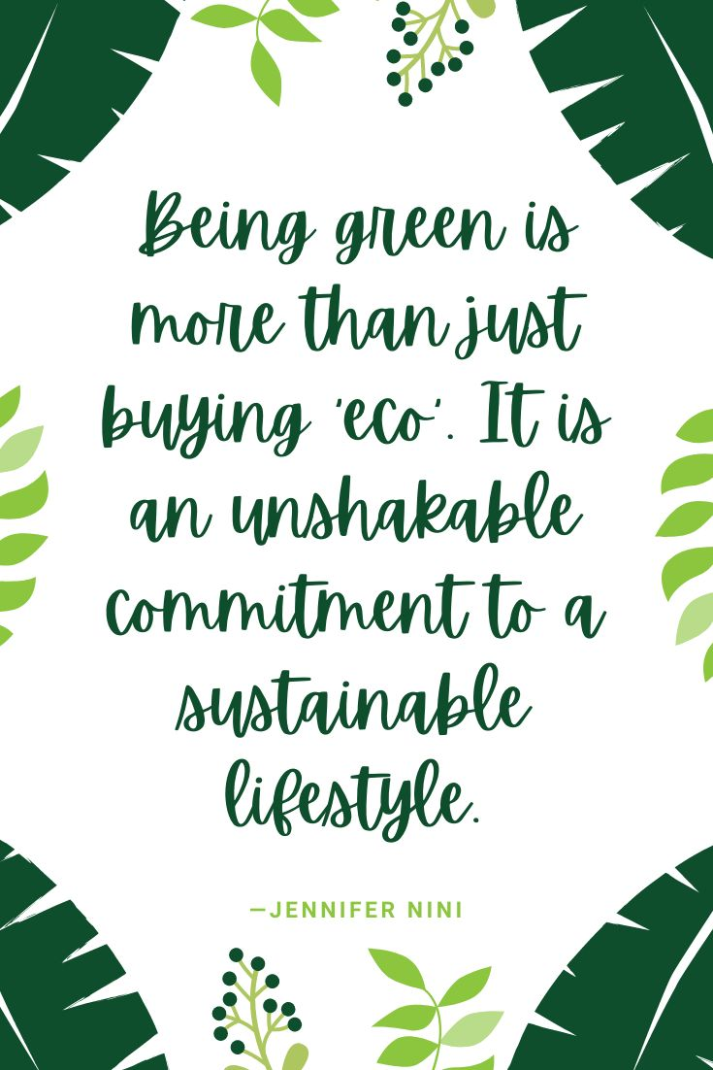
1. Sustainability

Slide 2

1.1. The concept: What does “sustainability” mean?
What does the word “sustainability” mean to you?
Write some words or short sentences on the post-its and put them on the white board.
Now read the text in your manual. Did you forget any particular and important words? Write them on the post-its and complete the brainstorm.
Put the words on your assignment paper.

Slide 3
1.1. The concept: What does “sustainability” mean?
Can you define the meaning of sustainability?
After the brainstorm and reading the text, you should be able to write down your own definition for the word “sustainability”.
Write your definition on your assignment paper.

Slide 4
1.1. The concept: What does “sustainability” mean? – resume of the text in the student’s manual
the ability to maintain or support a process
to prevent the depletion of natural or physical resources
conserving the natural resources
greater emphasis on the life support systems
meeting the needs of the present without compromising the ability of future generations to meet their own needs
a commitment to zero-waste packaging
to reduce overall emissions
continuous re-evaluation
using renewable energy or reducing waste
ways to reduce their impacts upon the planet and their community

Slide 5
1.2. When are you sustainable? – resume of the text in the student’s manual
a lifestyle and philosophy
choices and behaviours that focus on living within our means to encourage human and environmental health
prioritize the use of renewable resources
greenwash products and the eco-market
traditional ecological knowledge
can be expensive
individual choices don’t make the difference, but they do make a difference
chose to buy products from your local farmer
to eat a more plant-based diet
a widespread lack of accountability among governments and top polluters
no zero-sum game in environmental activism
consumption is all-encompassing, we consume food, energy, water, and material things like clothing
reducing our waste
repurpose items before throwing them in the trash
fair trade certifications

Slide 6
1.2. When are you sustainable?
What can you do to become more sustainable at home?
Make a list of actions you can use to become more sustainable at home.
You can use the text in your manual, internet sources or your own ideas.
Fill in your actions on your assignment paper.

Slide 7
1.2. When are you sustainable?
.
What is a sustainable salon?
Work in pairs.
Find a salon that is working sustainably in your opinion.
Prepare 10 questions you are going to ask the hairdresser(s) in the salon. Make sure you focus on sustainability.
Make a physical appointment or schedule an online conversation with camera.
Note the answers you get during the interview on your assignment paper.
Ask for illustrative material to include in your presentation.
Prepare a presentation about the sustainability of the salon.
Present your presentation to the class group

Slide 8
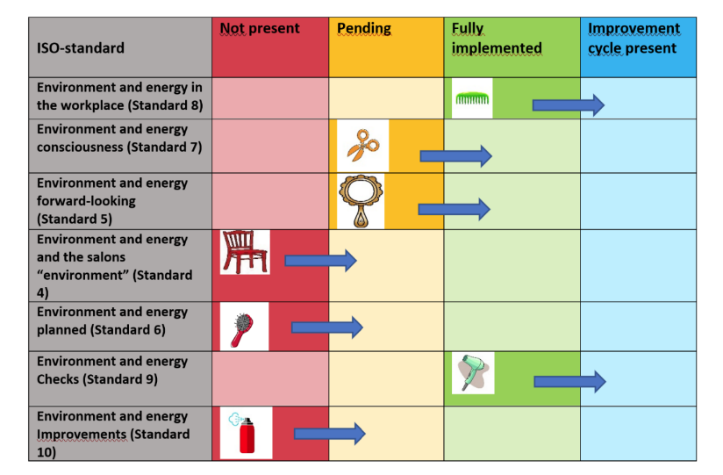
1.3. Scans on sustainability – resume of the text in the student’s manual
https://www.sustainable-salon.info/kopie-van-output-2-sustainability-syste
environmental care system

Slide 9
1.3. Scans on sustainability
Self-assessment tools on sustainability:
Divide in 3 groups to take the scans and process the results.
First group: You will take the awareness scan from 5 different teachers at 3 different hairdressing schools. You keep a good record of the results of the scans to create a clear overview in charts later.
Second group: You will take the awareness scan in 15 different salons, preferably across the country. You keep a good record of the results of the scans to create a clear overview in charts later.
First group + second group: You will take the extended scan in 5 different salons, depending on the need and the results of the awareness scan.
Third group: You will take the scan on organization context of a sustainable salon from 5 recently opened businesses (up to 1 year) and 5 salons that are already open for more than 1 year, but less than 5 years and 5 salons that are open for more than 5 years.

Slide 10
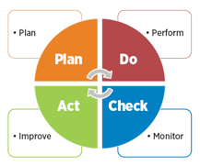
1.3. Scans on sustainability – extra information on the PDCA-circle
https://www.youtube.com/watch?v=dgazCOz_IIY
https://blog.ticktick.com/2021/01/28/pdca-cycle-explained/
https://en.wikipedia.org/wiki/PDCA
https://www.youtube.com/watch?v=RrWW4wDYf2k
https://www.youtube.com/watch?v=e4gOPeHSRo8

Slide 11
1.3. Scans on sustainability
Self-assessment tools on sustainability + PDCA-principles:
We divide into two groups.
Group 1: Make up a short term plan to achieve the goals set in the discussion from the previous assignment on the scans.
Group 2: Make up a long term plan to achieve the goals set in the discussion from the previous assignment on the scans.
Use the template on the assignment paper, including the PDCA-principles

Slide 12
TEST: Sustainability

Slide 13

2. Climate change

Slide 14
2. Climate change
Global warming:
Take a good look at the picture on global warming.
Give a concrete example for the given changes.
Use the grid on your assignment paper.

Slide 15
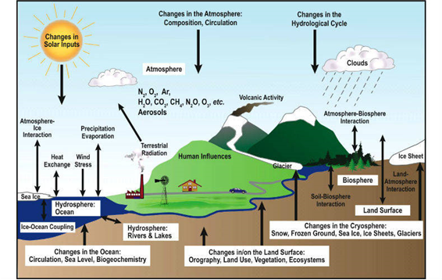

Slide 16
2.1. Definition: what is climate change? How does it happen? – resume of the text in the student’s manual
long-term shifts in temperatures and weather patterns
human activities have been the main driver of climate change
burning fossil fuels like coal, oil and gas
energy, industry, transport, buildings, agriculture and land use are among the main emitters
intense droughts, water scarcity, severe fires, rising sea levels, flooding, melting polar ice, catastrophic storms and declining biodiversity
can affect our health, ability to grow food, housing, safety and work
climate refugees
a 2.8°C temperature rise by the end of the century
cutting emissions, adapting to climate impacts and financing required adjustments

Slide 17
2.2. Unhealthy planet – resume of the text in the student’s manual
disease and early death are often due to environmental agents called pathogens
shortages of safe water
rising temperatures
changes in agricultural practices and clearing land for farming
a huge explosion occurred in population growth
industrial pollution
resource depletion
acid rain
ozone depletion
air pollution
global warming
hazardous waste
ocean pollution
water pollution
loss of biodiversity
land degradation

Slide 18
2.2. Unhealthy planet
Unhealthy planet – unhealthy people:
Read the article online or ask your teacher the text on paper.
Answer the questions on your assignment paper.

Slide 19
2.3. Climate conferences and sustainable development goals – resume of the text in the student’s manual
yearly conferences to assess progress in dealing with climate change
to negotiate the Kyoto Protocol to establish legally binding obligations for developed countries to reduce their greenhouse gas emissions
first UN Climate Change Conference was held in 1995 in Berlin
1997: Kyoto – Japan – Kyoto Protocol
2000: The Hague – Netherlands – very difficult meeting that lead to nothing new
2001: Bonn – Germany – flexible mechanisms, carbon sinks, compliance, financing
2010: Cancún – Mexico – Green Climate Fund, Climate Technology Centre
2015: Paris – France – The Paris Agreement = climate change reduction measures from 2020
2022: Sharm El Sheikh – Egypt - countries delivering a package of decisions that reaffirmed their commitment, specific fund for loss and damage

Slide 20
2.3. Climate conferences and sustainable development goals
Climate conferences:
Go to the following website: https://www.un.org/en/climatechange/paris-agreement.
Give the 3 key elements of The Paris Agreement.
Write them on your assignment paper.

Slide 21
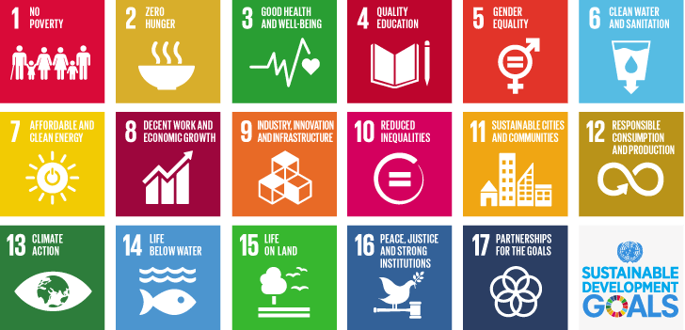
2.3. Climate conferences and sustainable development goals – resume of the text in the student’s manual

Slide 22
2.3. Climate conferences and sustainable development goals
Sustainable development goals:
Watch the video on Youtube: https://www.youtube.com/watch?v=b6qPnu82OVU
Answer the questions on your assignment paper.

Slide 23
TEST: Climate change

Slide 24
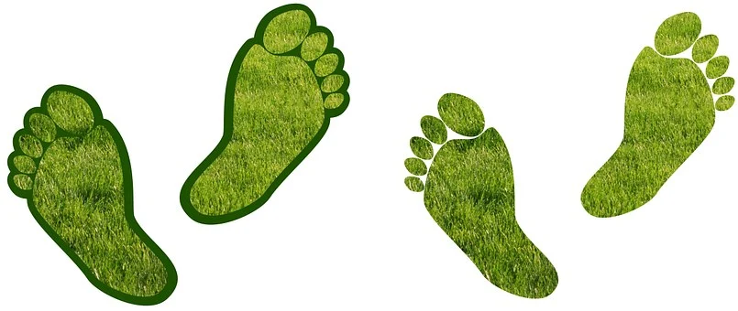
3. Carbon footprint

Slide 25
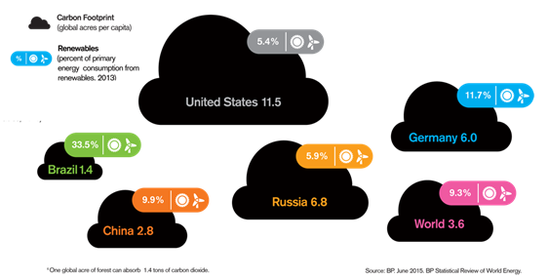
3.1. Definition: what is carbon footprint? – resume of the text in the student’s manual
the amount of carbon dioxide released into the air because of your own energy needs
the amount of carbon (usually in tonnes) being emitted by an activity or organization
the amount of productive land area required to sequester those carbon dioxide emissions
Paris Climate Agreement

Slide 26
3.2. The Consumer Footprint Calculator (general) – resume of the text in the student’s manual
to understand the impact of a person’s behavior on global warming
how you commute to work, what your usual diet is, how much you drive or fly, the size of your household, or what type of electricity the grid provides you
carbon footprint calculators use standard values that aren’t always right for a multiple of possible situations
to calculate the environmental impacts of your consumption pattern, as well as to evaluate how changes in your lifestyle may affect your personal footprint
five areas of consumption, namely food, mobility, housing, household appliances, and household goods

Slide 27
3.2. The Consumer Footprint Calculator
The Consumer/Carbon Footprint Calculator:
How big is your consumer and carbon footprint and what can you do to improve it?
Underneath there are different tests you can do on the internet.
https://knowsdgs.jrc.ec.europa.eu/cfc
https://footprint.wwf.org.uk/#/
https://eplca.jrc.ec.europa.eu/ConsumerFootprint.html
https://www.nature.org/en-us/get-involved/how-to-help/carbon-footprint-calculator/
https://footprintcalculator.henkel.com/en
Write down your results and measures of improvement on your assignment paper.

Slide 28
3.3. How to reduce your personal carbon footprint? – resume of the text in the student’s manual
transportation
food
water use
energy use
waste management

Slide 29
3.3. How do you reduce your personal carbon footprint
Reducing your personal carbon footprint:
Work in pairs.
Start up a campaign (poster, flyer) to make hairdressers aware of the impact of their carbon footprint and how to be as sustainable as possible.
Make sure you tick of all the criteria given on the assignment paper.

Slide 30
TEST: Carbon footprint

