Slide 1
Lesson 1
Water: a resource threatening to become scarce'

Slide 2
Student registration

Slide 3
Objectives of the lesson
for students to be able to look at the resource water and to get familiar with the problems around the threat that water becomes scarce
For students to know facts and figures about the threat of water becoming scarce
For students to have knowledge on how we can save water with simple steps, water pollution (Ocean clean-up project) and purification

Slide 4
Theme introduction
Water: a resource threatening to become scarce.
Fact: Can you imagine that a household uses around 130 litres of perfectly clean drinking water to do the dishes, operate a washing machine or flush the toilet?
Main question: what do you think is the cause of the threat?
Share your thoughts with the group

Slide 5
Facts and figures
over the past 40 years, the world’s population has doubled and use of water has quadrupled.
Today, about 4 billion people, representing nearly two-thirds of the world population, experience severe water scarcity during at least one month of the year.
Up to 40% of the world's population will be living in seriously water-stressed areas by 2035.
If we continue doing what we are doing today, by 2040, there will not be enough water to quench the thirst of the world population and keep the current energy and power solutions going.
By 2050, the world population will have grown to 9.7 billion people. Water demand is projected to grow by 55 percent, including a 400-percent rise in manufacturing water demand.

Slide 6
Saving water and why?
The main reasons for the growth of water scarcity on the planet:
the growing water demand due to the population growth,
higher living standards with increasing water demand,
the dietary consumption of more animal products,
expansion of irrigation in the agriculture.
Moreover, deforestation, the climate change (combination of floods and droughts), water pollution and wasteful water use (like flushing the toilet or operating a washing machine with clean fresh water) can result in the shortage of water supply.
For example in the Netherlands, the famous ‘water country’, in the last couple of years there’s been an impending water shortage, especially due to hot summers.

Slide 7
Tips to save water
Use a bowl in the sink when washing fruit, vegetables of dishes. You can then use the waste water to water your plants.
Fill a jug of water and put it in the fridge for when you want a cool drink.
Turn off the tap when you clean your teeth. A running tap uses up to nine litres of water a minute.
Wait until you have a full load before using your washing machine or your dishwasher. Some new washing machines use less than seven litres of water for each kilogramme of clothes, while modern dishwashers can us as little as 10 to 15 litres of water a cycle.
If possible, take a shower instead of a bath. A five-minute shower uses about 40 litres of water. This is about half the volume of a standard bath.
Use a water-saving device in your toilet cistern. Depending on the size of your cistern, you could save between one and three litres each time you flush the toilet.
Using a watering can in the garden instead of a sprinkler or a hosepipe. Garden sprinklers and hosepipes left running can use between 500 and 1000 litres of water an hour.
Think about fitting a water butt to collect rainwater off your roof. Water butts usually store about 200 litres of water. As well as being better for watering your plants, using rainwater in the garden reduces the amount of treated water you use.
Check your property regularly for leaks on your internal plumbing.
Try shortening your regular shower routine with 2 minutes (make it for example 5 instead of 7 minutes). Also making your water temperature 1-2 degrees lower will help you save some energy and is good for your health (if you have heard about the Ice Man Wim Hof, then you know that. Otherwise look up the Wim Hof method online!)

Slide 8
Water pollution

Slide 9
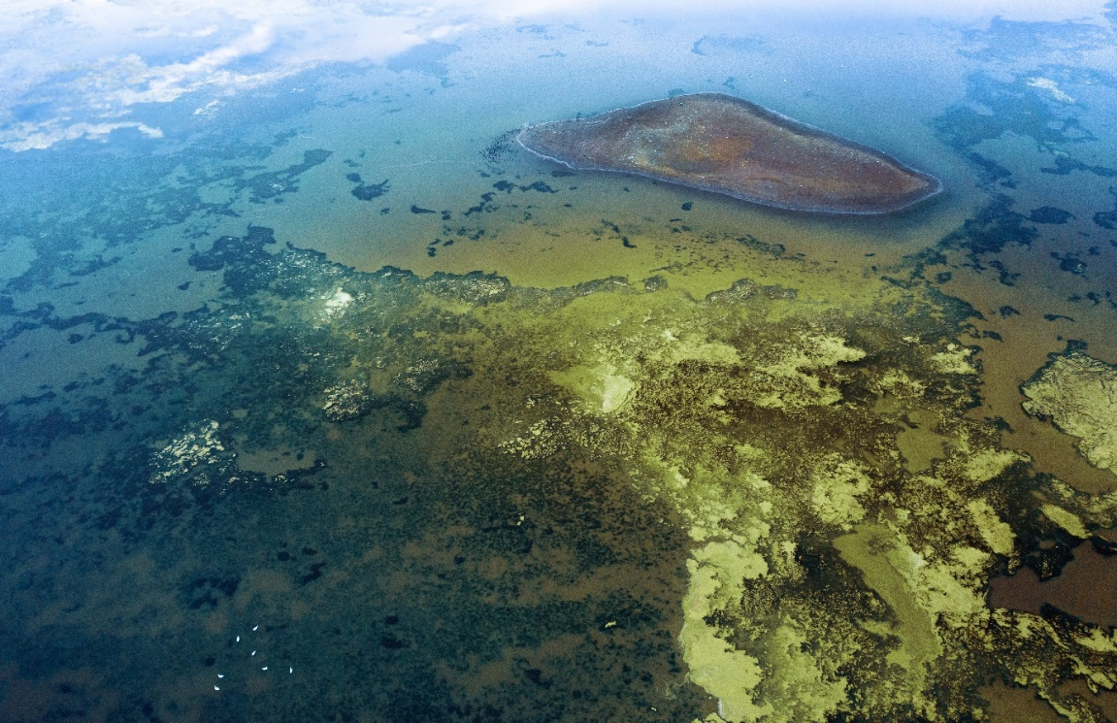
Causes of water pollution
Agriculture
Sewage and wastewater
Oil pollution
Radioactive substances

Slide 10
Student activity
Answer the following questions and write down your findings
What do you see as one of the major risk for water pollution in your region?
And in hairdressing?
Which of the 4 causes presented earlier belongs this risk to?

Slide 11
Evalation and self-study
Any questions so far?
What are we going to do next week?
Self-study: read the paper about water purfication by the award-winning company Hydraloop

Slide 12
Lesson 2
Water pollution and water purification

Slide 13
Student registration

Slide 14
Objectives of the lesson
For students to understand the concept purification
For students to experiment with filtering water

Slide 15
Exeriment explaintion
You will get from me a filter + waste water
The waste water contains: sand, gravel or hair coloring
Filter the water 3 times and see the results
Write down the findings of the experiment

Slide 16
Experiment aftertalk
What was the main goal of this experiment?
What did we learn?
Do you think they use this system as well for the main industry?

Slide 17
Evalution
Any questions?
What are we going to do next week?

