Slide 2
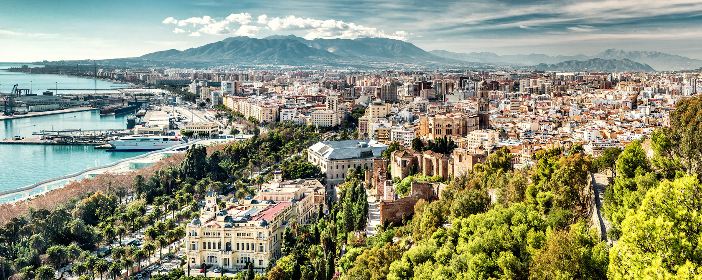
Málaga… la bella

Slide 3
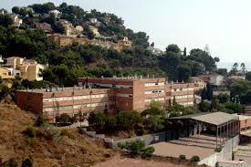
IES El Palo since 1979
Compulsory secondary education.
High school.
Vocational training (Personal Image).

Slide 4
Vocational training at IES EL PALO
HAIRDRESSING
IMAGE CONSULTING
Intermediate vocational training
Advanced vocational training
Hair styling.
Hair dying.
Hair cuts.
Hair updoing… and more.
Dress styling and dress code.
Beauty and hairdressing consulting.
Corporate image.
Communication skills… and more.

Slide 5
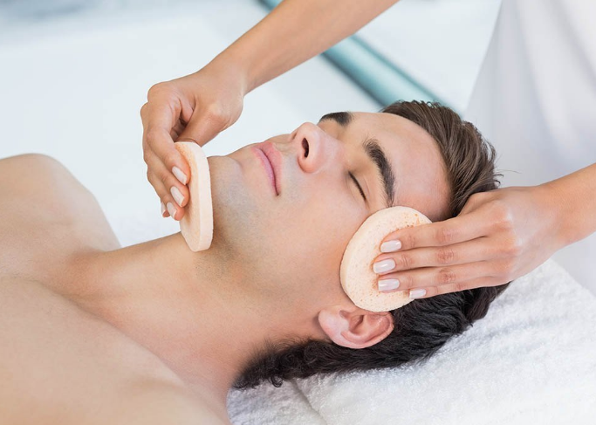
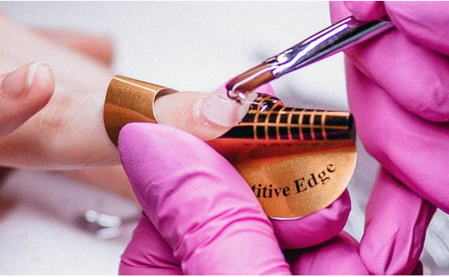
BEAUTICIAN
BEAUTICIAN
HAIR AND BEAUTY
Advanced vocational training
Intermediate vocational training
Basic vocational training
Massage and lymphatic drainage.
Spa and hydrothermal treatments.
Micropigmentation.
Electro-aesthetics… and more.
Make up.
Nails.
Waxing.
Basic beauty treatments… and more.
Hair styling.
Hair dying.
Manicure.
Make up… and more.

Slide 6
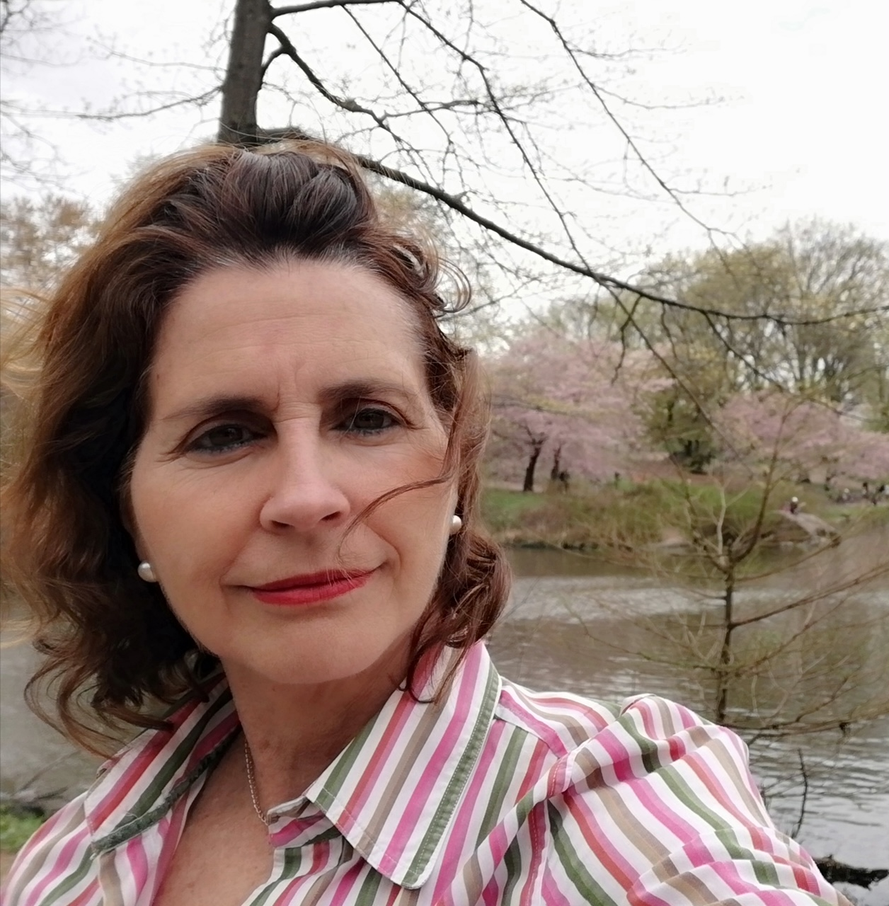
THE TEAM:
THE BOSS
Paloma Rodríguez
Project manager and international coordinator at IES El Palo. Degree in Law and Master in International Trade.
Lecturer on entrepreneurship.
Teaches Law and Health and Safety to Personal Image students.
Committed to the internationalization and networking of vocational training.
Participated in different European projects since 2008.

Slide 7
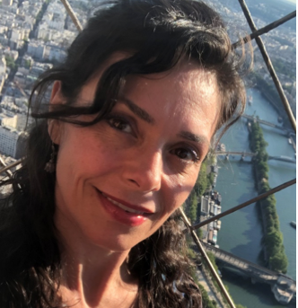
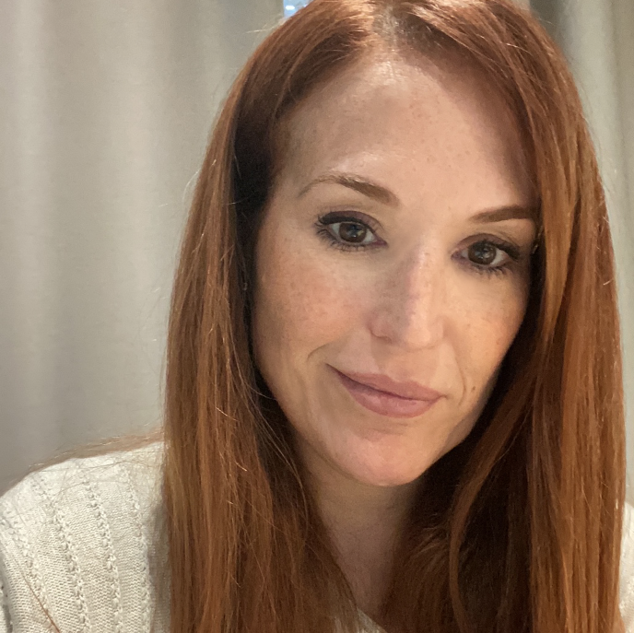
THE TEAM:
THE OBEDIENT ONES
Esther López
Marta Guillén
Image consulting and hairdressing teacher.
Hairdressing lecturer.
Used to work in Wella as Training Director.
Trainer and consultant on salon management, catwalks, and marketing new products.
Participated in the former Green Salon project.
Image consulting and beauty teacher.
Writer of 16 professional books on Beauty and Image.
Organizes and coordinates intensive courses for teachers in this sector.
Developer of international marketing projects.
Used to run her own beauty and image consulting salon.
Participated in the former Green Salon project.

Slide 8
Gracias THANK YOU

