Slide 1
Richtpunt campus Oudenaarde
Belgium

Slide 2
PROJECTTEAM
Koen De Clercq
Technical Advisor Coordinator
Lindsy Van de Perre
Teacher
Coordinator dual learning

Slide 3
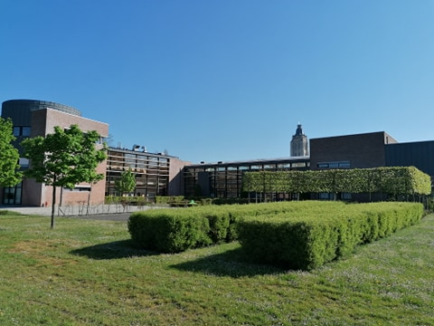
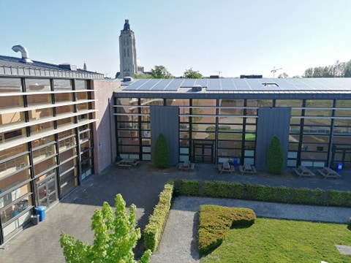
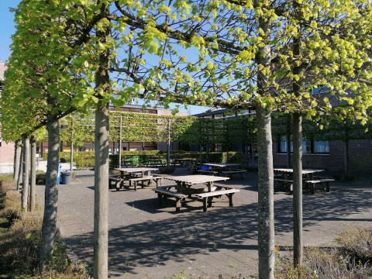
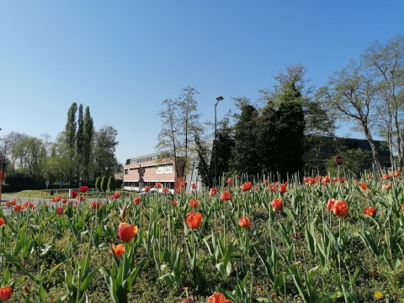

Slide 4
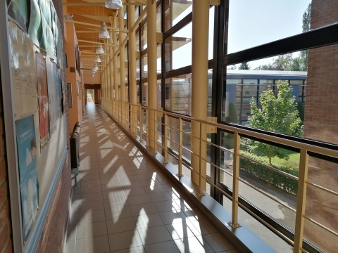
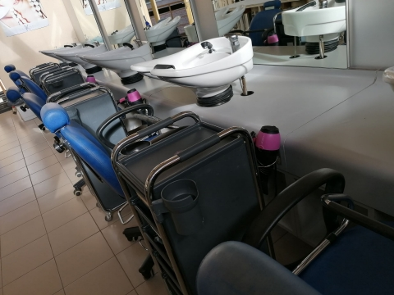
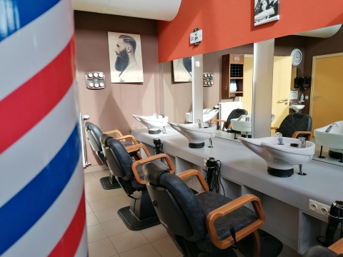
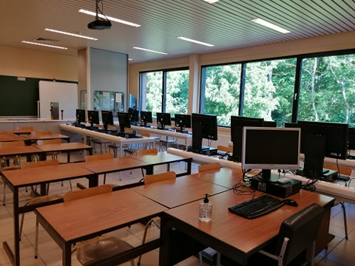

Slide 5
Hairdresser - beautician
Vocational training
6 years
Dual learning
3 years
1 year after finishing secondary school
Since 2021: education reform
1 year of specialisation
Barbering
Styling & imago

