Slide 1
Lesson 1
Why is waste a growing problem in nowadays 'linear economy'

Slide 2
Student registration

Slide 3
Objectives of the lesson
For students to understand the concept of recycling and the threat of waste
For students to have knowledge on the benefits of reusing and recycling
For students to have knowledge of waste management

Slide 4
Group activity
Make a group from 3 or 4 students
Find facts and figures on the internet about waste and how to reduce
Write down your findings
Share your thoughts with the group

Slide 5
Why waste is a growing problem?
Global waste is expected to grow to 3.40 billion tonnes by 2050, more than double population growth over the same period.
There is a positive correlation between waste generation and income level. Daily per capital waste generation in high-income countries is projected to increase by 19 percent by 2050, compared to low- and middle-income countries where it is expected to increase by approximately 40% or more.
Taking into account the predicted world population growth in the coming years, the solid waste generation is possible to become an even bigger and more alarming problem.

Slide 6
Video about reduce – reuse - recycle

Slide 7
Aftertalk video
What is your first thought of this video?
Do you think we can recycle more?
What can we recyle?

Slide 8
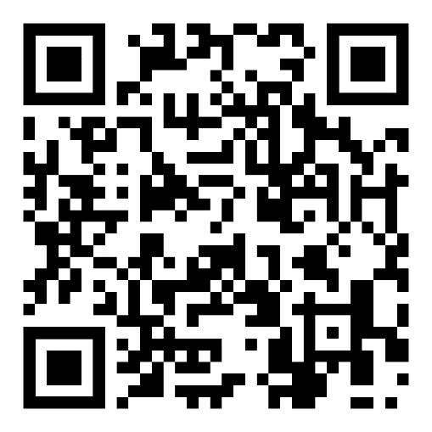
Student activity: microplastics
Make pairs
Download the app through scanning the QR-code
Check all the products you have with you through this app
Did you find any products with microplastics?

Slide 9
Evalation
Any questions so far?
What are we going to do next week

Slide 10
Lesson 2
Circular economy and waste as the new raw material

Slide 11
Student registration

Slide 12
Objectives of the lesson
Getting acquainted with concept of circular economy
Getting acquainted with waste as a new raw material
Experiment with recycling paper

Slide 13
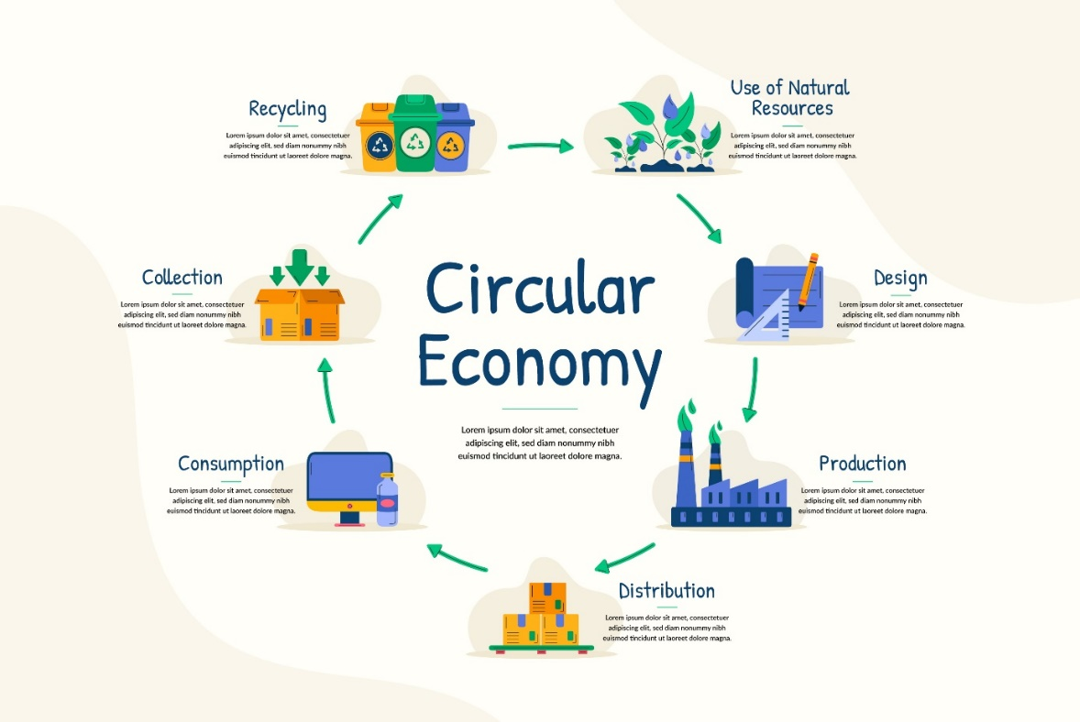
Circular economy

Slide 14
Waste as a new raw material
In a circular economy, waste is the new raw material. There is no longer the line (as in the linear economy): produce, consume and then throw it away. This saves raw materials, the environment and reduces CO2 emissions. It stimulates innovation, new business activity and employment.
In a circular economy, nearly all products used by people will be reused again and again. If a product is broken, it will be repaired. And if that is no longer possible, new products are made from it.
In a circular economy, manufacturers design products to be reusable. For example, electrical devices are designed in such a way that they are easier to repair. Products and raw materials are also reused as much as possible. For example, by recycling plastic into pellets for making new plastic products.

Slide 15
Experiment: paper recyling
Check the following video for inspiration:
https://youtube.com/shorts/8LsVgiIupII?feature=share

Slide 16
Experiment: paper recyling
Grab the paper/carton and make it into tiny pieces
Throw it in the blender mixed with a bit of water to make a pulp
Make a frame out of icecream sticks, glue and thin fabric
Throw the pulp in a bucket of water and mixed it
Use the frame to get the pulp onto the thin fabric (a thin layer)
Drip the water out
Let the recyled paper dry
Use the paper to make notes and to try it out once it is dry

Slide 17
Evalution
Any questions?
What did we learned so far?
What did you think of this experiment?

