Slide 1
Future skills for a better life in Sustainable Salons Financial information on your project administration
Eva Bouwman
Frank den Hartog
Milan, Oct. 6-8, 2021

Slide 2
Contractual obligations
The money €€€€€
Reporting (by coordinator to agency)
Final payment
Budget shifts
Amendments
Hour registration:
Project Management & Implementation
Intellectual outputs
Costs registration:
Partner meetings (travel, subsistence)
Exceptional costs (budgeted, like expert costs)

Slide 3
The money €€€ - (pre)payments:
Show me the money!
The maximum amount of the grant is:
€ 387.309,00
First 2 years prepayment: 35%
Last year prepayment: 35%, based on budget activities and work done, after approval of interim report and 70% of costs made
3rd and final payment: 30% after project ending, after approval of final report.

Slide 4
Reporting (by coordinator)
The Project runs for 36 months:
starting on 1-9-2020 and finishing on 31-8-2023
Progress report: 30-09-2021 = implementation of the Project’s first year
Interim Report: 30-09-2022 or once at least 70% of the first pre-financing payment has been used = implementation of the Project’s first two years
Final Report: 31-10-2023 = 60 days after the end date of the Project (covering 36 months); including upload of all project results.

Slide 5
Final payment
Final report = request for payment of the balance of the grant.
Last payment of the National Agency to Stivako and from Stivako to the partners:
Final payment NA to Stivako: under normal circumstances latest 60 days after submission of final report and its approval (max = 31-12-2023).
Last payment Stivako to partners: latest 60 days after payment NA to Stivako (max = 01-03-2024).
Stivako has to send proof of all payments to NA.

Slide 6
Budget shifts
Transfer of 60% is allowed between the different budget categories without requesting an amendment, as follows:
Shifting budget to Project management and implementation and to
Exceptional costs is not allowed!
From: Transnational Project Meetings Multiplier Events Learning/teaching/training activities Exceptional costs | To: Any other budget category: Staff costs Transnational Project Meetings Multiplier Events Learning/teaching/training activities

Slide 7
Amendement
• Change of partners
• Major changes in workplan
• Other specific (organisational) changes
• Submission is latest one month before the end of the project, with consent of all partners.

Slide 8
Justification of staff that works on the project and write hours:
Hour registration
proof of the nature of the relationship between the person and the beneficiary concerned:
type of employment contract: temporary, indefinite, 0-hour contract, voluntary, SME ownership, etc.
Proof of contract: only on request of coordinator

Slide 9
Hour registration
Proof of the staff time, invested in the production of the intellectual output, being:
Time sheet(s) per person, identifying:
* the name of the person,
* the category of staff (in this project ONLY: teacher/trainer/researcher)
* the dates and worked hours per day
* description of activities per days worked
* total of days worked per intellectual output and management.
Time sheets of employees only (next slide)

Slide 10
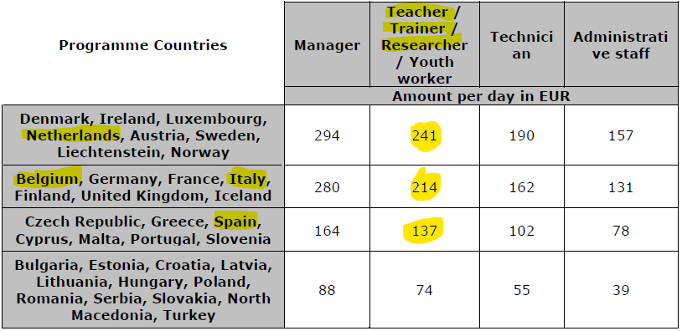

Slide 11
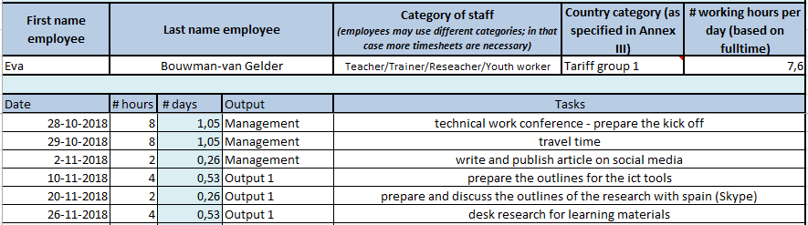

Slide 12
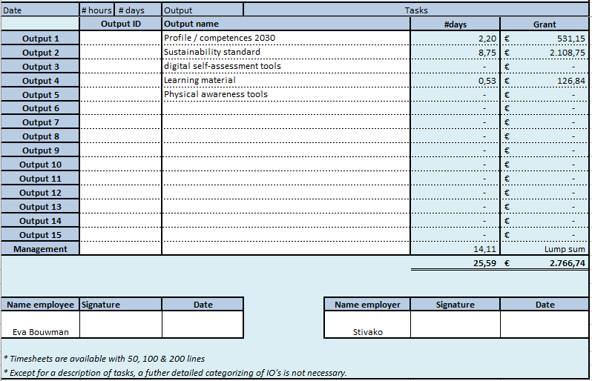

Slide 13
Multiplier event
Malaga/El Palo d(Q1-2022) – 50 x 100,- = 5000,-
Italy/IVL (Q2-2023) – 75 x 100,- = 7500,-
Supporting documents:
Proof of attendance of the multiplier event in the form of a participants list signed by the participants and the receiving organization, specifying the name, date and place of the multiplier event, and for each participant: name and signature of the person, name and address of the sending organization of the person (if applicable);
Detailed agenda and any documents used or distributed at the multiplier event.
Virtual possibilities: Extra rules apply on funding and organization (only if necessary and physical event is not possible).

Slide 14
Multiplier event
Reporting:
On behalf of the Project as a whole, the coordinator must report on:
the description of the multiplier event,
the intellectual outputs covered,
the leading and participating organizations,
the venue of the meeting
and the numbers of local and international participants

Slide 15
Travel & subsistence (lump sum)
Proof of costs made: only on request of coordinator
travel as cheap as possible (1st class train or plane not accepted)
Register the costs:
Own transportation – declare per km with prints of Maps (A to B); use the amount p/km as used in your institute.
Invoices with boarding passes/tickets (prints)
Internet prints on public transportation (train/bus/etc.)
Travel costs is from home to end destination.
Keep all receipts (restaurants etc.)

Slide 16
costs registration
Register per partner meeting per participant:
travel costs (from door to door transport costs)
Subsistence costs (local travel, food & beverages, hotel)
Meeting group costs divided and paid to Stivako afterwards
Total amount (e.g. in Excel)

Slide 17
Exceptional costs
Building the two self assessment tools, technical assistance, including software licenses domain names, maintenance etc. , etc.)
-> in this project only applicable for Stivako (see planning / budgets).

Slide 18
General regulations for costs
Justification for all (out of pocket) costs made
Invoices/declarations other than in NL/UK/DL: short translation
VAT-liable partners may not claim VAT
copy of document of exemption in case of non-VAT liability

Slide 19
Costs
Keep a clear record with documentation to support the costs declared.
Each beneficiary must provide the following if requested:
For actual costs (out of pocket): adequate supporting documents to prove the costs declared, such as contracts, invoices.
For lump sum costs or lump sum contributions: keep all adequate supporting documents to prove the costs (receipts, boarding passes).

Slide 20
Checks & audits
All partners may be subject to checks and audits (local NA)!
For the final report: supply copies of supporting documents to the NA of all exceptional costs of all partners.
If selected for a further desk check or on-the-spot check: submit supporting documents for all budget categories.

Slide 21
GOOD LUCK!!!

