Slide 1
Sustainable Salon Making the standard
Milano/Pavia, Italy
Frank den Hartog

Slide 2
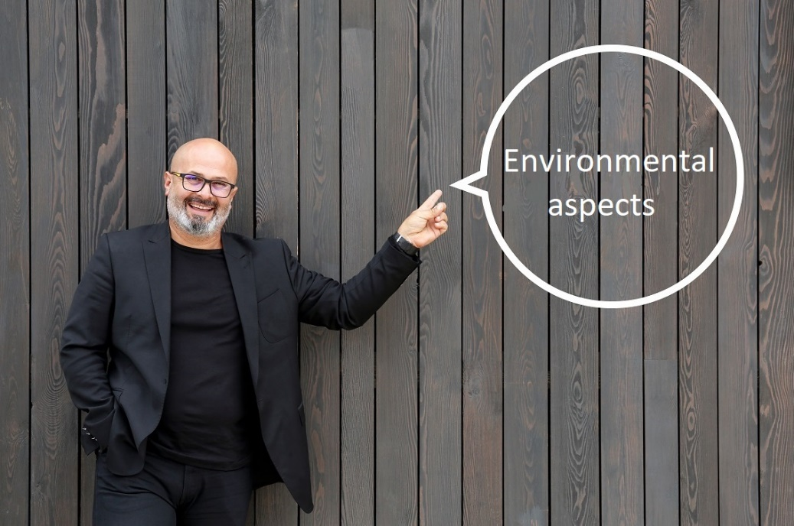
1:Identifying processes or working from an environmental theme in the sustainable salon or school department
The environmental impact of each process must be mapped out for the various aspects.
Processes
shampooing
cutting
dyeing
perming
styling
nails
management

Slide 3
1:Identifying processes or working from an environmental theme in the sustainable salon or school department
Processes not mentioned
laboratory and recycling area
storage and laundry room
reception and waiting area
applying wigs, extensions and hairpieces
barbering

Slide 4
2:Aspects of environment
The environmental impact of each process must be mapped out for the various aspects:
Water
Energy
Soil
Air/odor/emissions (ammonia, peroxide and formaldehyde)
Raw and auxiliary materials (Raw materials are supplies, objects and materials that are converted into products or services. Auxiliary materials/Consumables are also products, materials or supplies, but these are not converted into products/services but consumed. This concerns, for example, the necessary maintenance products or small tools etc.)
Waste
General

Slide 5
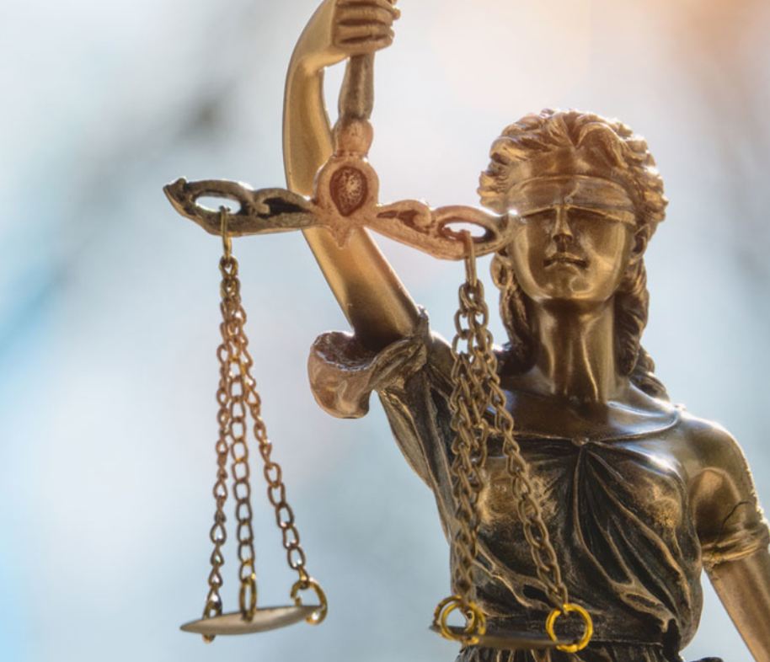
3: Mapping relevant legislation and regulations
‘Companies must comply with laws and regulations. Laws and regulations can be at international, national, and local level. Given the involvement of European partners in this project, it is important to map out at least the European level of legislation and regulations. European laws and regulations will apply to all partners.
Uni Laboral: makes an inventory of the applicable legislation and regulations at European level on the aspects: Water, Energy, Soil, Air/odor/ emissions, Raw and auxiliary materials, Waste and In General.

Slide 6
4: Per aspect defining the points of control
Points of control of each environmental aspect:
Water, Energy, Soil, Air/odor/ emissions, Raw and auxiliary materials, Waste and In General.
Examples of point of control:
The employees always switch off the lighting, computers and other equipment after the end of working hours.
To what extent are employees aware of the hazardous aspects of the substances with which they (may) come into contact.

Slide 7
4: Per aspect defining the points of control
Examples of point of control:
Correct collection of Small Hazardous Waste (batteries/accumulators/spray cans, etc.) takes place via the SHW-box
The employees in the Salon/School department are sufficiently aware of the operation of the environmental rules (system).
General cleaning activities are only carried out with household (glass) cleaning agents.
Etcetera

Slide 8
5: Assessing and assigning the weight of each control point associated with the aspect
We must give weight to the different environmental aspects per workplace. This can be done by entering various levels.
Entry level: has made a start with the introduction of various environmental aspects but does not yet meet all legal requirements.
Bronze complies with European laws and regulations.
Silver: also meets specific national requirements.
Gold: does more than the law requires and works on continuous improvement.

Slide 9
6: Making of the (internal) audit form
The various aspects are recorded in an audit list. This allows the school, (teacher and student), the external auditor, the internal auditor (advisor, salon owner or employee) to check whether the salon meets the requirements and determine the points for improvement.

Slide 10
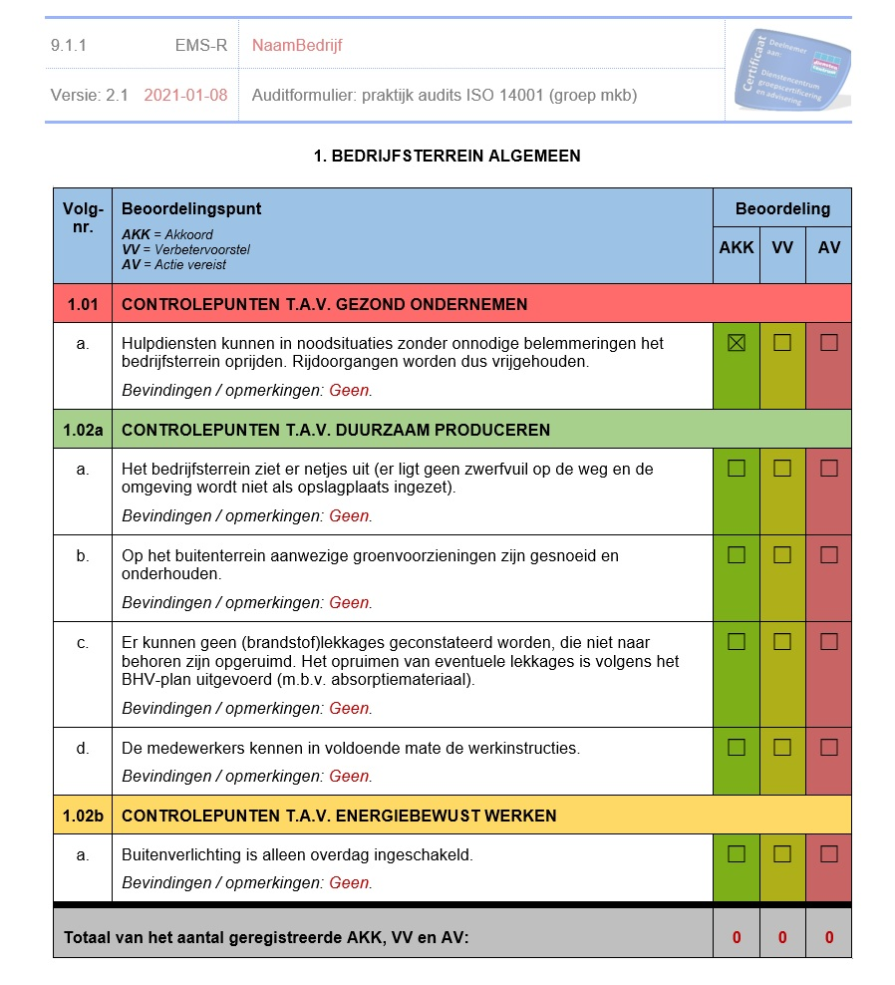
6: Making of the (internal) audit form

Slide 11
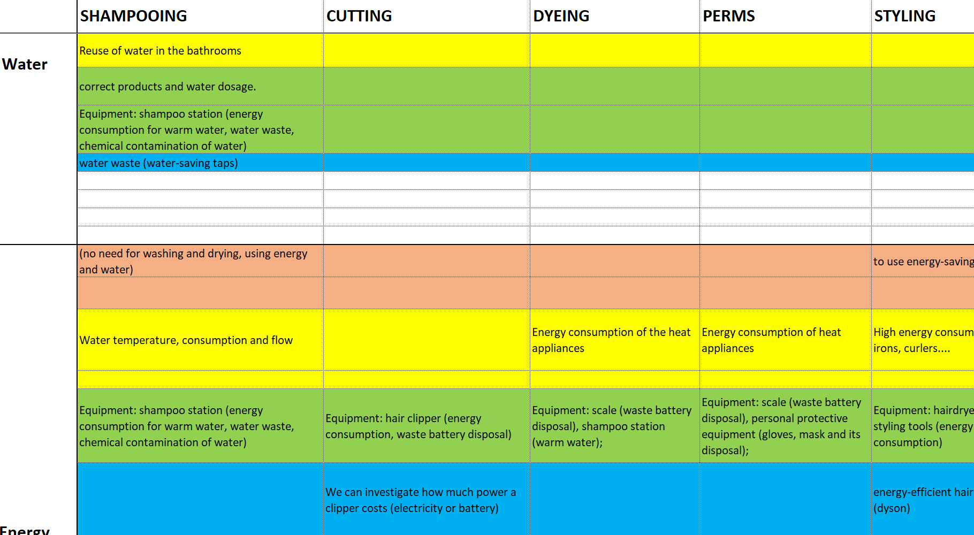
Activities
1.Identifying processes
2:Aspects of environment
3. Defining the points of control

Slide 12
Questions/remarks

