Slide 1
Legislation around water and setting up a water-efficient salon
Management level students' class

Slide 2
Index
Legislation (rules and laws) about water and water pollution in your country / region
Why is it important to know the rules and laws?
Giving water-saving advice [task]
Water saving as part of the business plan for your Dream Salon [task
Recap: what have you learned?

Slide 3
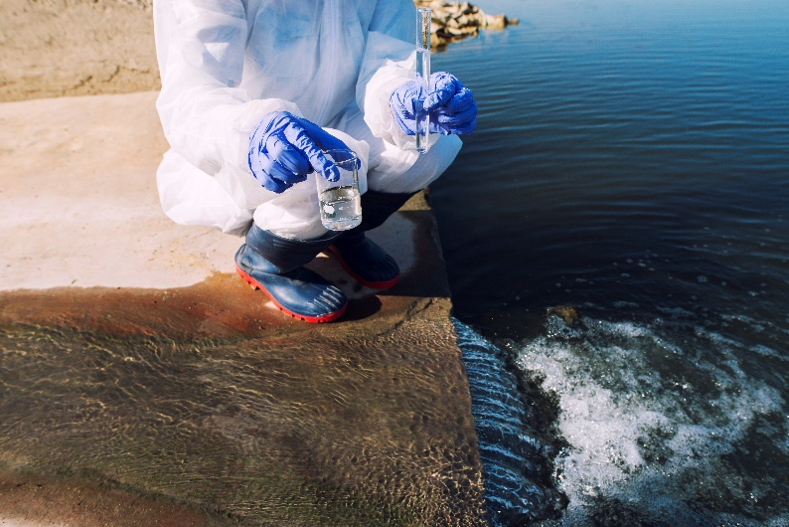
WATER LEGISLATION RESEARCH ASSIGNMENT
Doing short research on legislation concerning water and water pollution in the country: Is there a special law dealing with the issue? If not, maybe there are institutions that deal with water policies and rules? How do those law(s) / rules apply to hairdressers? Please study the water protecting law(s) – if applicable – and find out the main points of it. What does it say about water pollution? Are there any other measures concerning water usage or waste water utilization the entrepreneurs need to be concerned about?
In most (European) countries the distribution and purification of water is regulated by law.
In pairs / groups of max 4: do online research on the water legislation in your country or region (whichever applicable)
Image by aleksandarlittlewolf on Freepik

Slide 4
Why is it important to know the rules and laws?
You are planning to become a hairdressing salon manager / owner in the future (if not, imagine that you are!)
Think about this:
Why is it important for a business owner to be aware of the rules and legislation? If he/she has no personnel? If he/she also employs people?

Slide 5
Implications of water-related rules and laws for hairdresser salon owner / manager
What implications do the water-related rules and laws have for hairdresser salon owner / manager?
Does it become clear from the legislation you discovered in the previous assignment?
If it is not completely clear, where can you as a young entrepreneur, look for help?

Slide 6
Optional: giving water-saving advice assignment
You are going to give advice to an owner of a hairdresser salon in order to save water taking the legislation into account and trying to minimize the costs
Write down 3 to 5 tips how to make sure the water is not wasted unnecessarily. Think of all the hairdressing processes (shampooing, cutting, colouring, perming) and other processes at a salon (e.g. washing the towels, washing the dishes, mopping the floors etc.).
My /our water saving tips to a hairdresser salon owner are:
1.
2.
3.
4.
5.

Slide 7
Optional: water saving as part of the business plan for your Dream Salon
Work individually
Imagine you were writing a business plan to get a financing from the bank for opening a salon of your own. Since in the South of Europe (imagine you are located there even if you are not!) the expectation is that access to water will become less and less abundant in the near future, a decent water saving plan is an important condition for getting this financing.
What steps and procedures would you add to your business plan to convince the bank you have thought about water saving steps in your future salon? What about minimizing water pollution?

Slide 8
Recap – what have you learned?
What do you know about water-related legislation in your country or region?
Why is it important for a salon owner to have some knowledge of the legislation?
Can you give a salon owner water-saving advice? Can you advise on minimizing water pollution at a hairdresser salon?
How can you integrate your knowledge about water-efficiency at a salon into a business plan of your Dream Salon?

Slide 9
Corporate Social Responsibility and water at a hairdresser salon
Management level students' class

Slide 10
Index
Corporate Social Responsibility (CRS)
CRS in relation to water
Examples of water-related CRS
Companies offering products or services to help a salon owner in more efficient water-management
Water-related CSR as a marketing tool

Slide 11
Corporate Social Responsibility (CRS)
Corporate social responsibility (CSR) is a self-regulating business model that helps a company be socially accountable to itself, its stakeholders and the public. By practicing corporate social responsibility, also called corporate citizenship, companies can be conscious of the kind of impact they are having on all aspects of society, including economic, social and environmental.
To engage in CSR means that a company is operating in ways that enhance society and the environment instead of contributing negatively to them. CSR helps both improve various aspects of society as well as promote a positive brand image of companies, thus creating a win-win situation.
Image by rawpixel.com on Freepik

Slide 12
CRS in relation to water and water management
With some previous knowledge about water-efficiency at a hairdressing salon, can you think of the following:
What CRS practiced in relation to water and water-efficiency can be applied at a salon?
How can a salon manager / owner facilitate the use of these practices?
Can a salon manager / owner use incentives / renumeration system to motivate the employees to apply the water-related CSR at a salon?

Slide 13
Examples of water-related CRS
Join-the-Pipe – great example of water-related CSR project:
WORK IN PAIRS / SMALL GROUPS Study the website of Join the Pipe (scan the QR).
What can you tell about the mission of the project?
Can a hairdresser salon owner work together with the organisation?
What are the collaboration opportunities for (small) businesses you can find about on their website?

Slide 14
Companies offering products to help a salon owner in more efficient water-management
There are companies which help an entrepreneur (an owner of a hairdressing salon) with for reducing, reusing or purifying the water
E.g. Hydraloop, companies producing water-saving faucets, showerheads etc.
WORK IN PAIRS / SMALL GROUPS
Look up 2 or 3 of these companies on the internet. What kind of principle(s) is their water-saving or water-purifying solution based on?
Do you know any salons or other companies that use an independent water-recycling system? If not, try to find them online

Slide 15
Water-related CSR as a marketing tool
Customers nowadays become more and more environmentally conscious!
If you are using (water-related) CSR in your salon, make sure to:
Promote these kind of practices in your marketing communication by:
Hanging around some posters that you save water
Adding a disclaimer on your website or social media that you are saving water / sorting waste / using green hair and scalp products
are awarded a quality mark or certification etc.

Slide 16
Recap – what have you learned?
What is CRS?
What is CRS in relation to water and in the context of a hairdresser salon?
Learned about a good water-related CSR example\
Looked at companies helping entrepreneurs have a better and more efficient water-management
How and why your can use your water-related CSR as a marketing tool

