Slide 1



Lesson 5
Water pollution by hairdressers

Slide 2

Student registration

Slide 3
Objectives of the lesson
Introducing the notion of water use / water pollution per workstation at a hairdresser salon
Looking at ways to minimize the damage and save up water at a salon

Slide 4
Theme introduction – group activity
Think about ways that hairdressers pollute the water
Write down your findings
Share your thoughts with the group

Slide 5
Workstation: cutting
For hair cutting, most of the time you use shampooing and conditioner application beforehand. Shampoos and conditioners are polluting the water after being rinsed off into the sewer. Try to wash the hair once, use as little product as possible (they are all well concentrated).
Use drip trays and dose limits, make sure that the screw caps are closed well after use.
Make use of sustainable and environmentally friendly shampoo (without PCB)
You might also consider asking your customer to wash their hair before coming to the appointment for a haircut – this will not save the water in general, since the customer would use the same amount of water at home, but this way you might avoid an ‘unplanned’ shampooing turn.

Slide 6
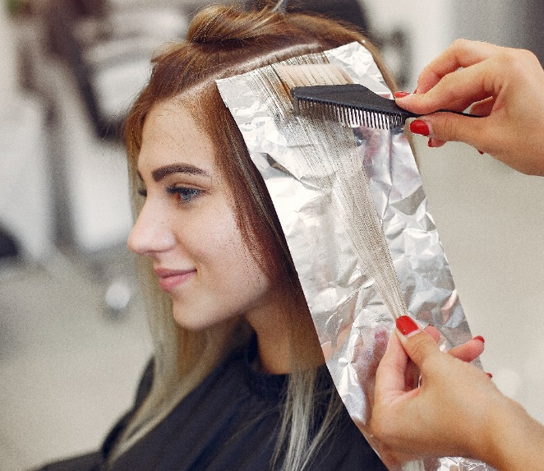
Workstation: coloring
Chemical residues are polluting the water. Try to avoid ammonia and sulphates in the products and use vegetable colours whenever possible.
To reduce the use of water while rinsing the colouring product, use water-saving water taps. There are for example water tap nozzles available that pulverize the water allowing to use less for the same purpose.

Slide 7

Workstation: perm
Chemical residues form the perm liquid are polluting the water.
To reduce the use of water while rinsing the perming product, use water-saving water taps. There are for example water tap nozzles available that pulverize the water allowing to use less for the same purpose.

Slide 8
Student activity
Make a group of 3 /4
Use your device to search on the internet
Find ways to solve this problem by hairdressers
After 10 minutes you present the information you found

Slide 9
Student presentations

Slide 10
Evaluation
Any questions?
What did we learn today?

Slide 11
Lesson 6
Practical class - Measuring to save water at a salon

Slide 12
Student registration

Slide 13
Objectives of the lesson
Becoming aware / measuring the amount of water used for different treatments
Making the effects of using a water saving device visible

Slide 14
Experiment 1 – regular shower head
Students to work in small groups of 3.
Model
Hairdresser
Timer
1 group washes the hair of someone with short hair
1 group washes the hair of someone with middle length hair
1 group washes the hair of someone with long hair
The timer student times the minutes on how long the treatment is.

Slide 15
Experiment 2 – water saving shower head
Students to work in small groups of 3.
Model
Hairdresser
Timer
1 group washes the hair of someone with short hair
1 group washes the hair of someone with middle length hair
1 group washes the hair of someone with long hair
The timer student times the minutes on how long the treatment is.

Slide 16
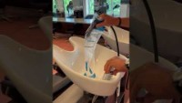
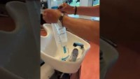
Calculation & comparing
See following short videos:
10 seconds = 9 litres
2 liter difference
Make your own comparison

Slide 17
Summary how to save water by hairdressers
Be aware of your water use
Avoid wasting water
Choose the right products and inspire others to do the same (for example, hair colouring products without ammonia or preferably plant-based colouring products)
Use water-saving shower- and water taps
Only turn on the washing machine and dishwasher when it is full
Eat less meat (since meat industry uses humongous amounts of water!) and buy as many products as possible that are organic

Slide 18
Evaluation
Any questions?
What did we learn today?

