Slide 1
Future skills for a better life in Sustainable Salons
Develop questionnaire, status profiles and status material on entrepreneur skills.
IES EL PALO
Málaga

Slide 2
Summary
SECTION 1. Surveys and information about the sector. Programs, courses and modules.
Hair and beauty.
Entrepreneurship.
Digitalization and digital skills.
Sustainability
SECTION 2. Year 2020. Demands and Competences/profiles/skills in the sector.
Entrepreneurship.
Digitalization and digital skills.
Sustainability
SECTION 3. Year 2030. Trends, future demands/skills.

Slide 3
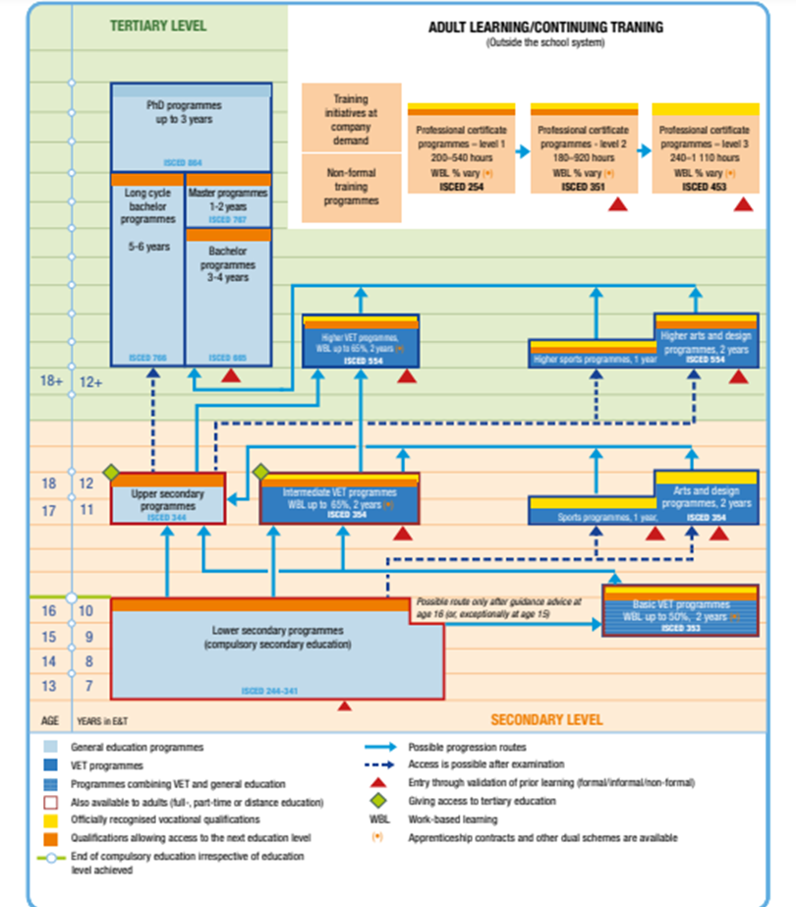
VET in Spain's education and training system
The Spanish education system
is not referenced to EQF levels.
Source: Cedefop and ReferNet Spain.

Slide 4
Profesional qualification
Professional Certificates
Employ authorities:
VET Diplomas
Education authorities
Expressed in learning outcomes.
They are based on occupational standards
listed in the national catalogue of
occupational standards (CNCP).

Slide 5
Conclusions Section 1
Wide offer of courses, seminars and programs.
Not all the formative offer is oficially recognised.
Formal education is mainly face to face but there are distance and flexible learning courses as well.
Hair and beauty formal education includes compulsory work placement modules and entrepreneurship abilities.
A Plan for the modernization of VET in Spain has recently been approved, and from 2022 it is planned a professional module on digitization applied to the productive sector.
Sustainability isn´t included as a whole in the official curricula of formal VET. However, Education for Sustainable Development will be included in all formative stages by 2024.

Slide 6
Conclusions Section 1
Outside formal VET
Private academies offer training courses on the use of digital tools to the management of hairdressing salons
Several companies as LÓreal and Wella are involved in the sustainable development and offer training courses not only for their employees but also future hairdressers and esthetician

Slide 7
Year 2020. Competences/profiles/skills in the sector
General attitude of customers, entrepreneurs and salon owners in the hair and beauty sector with regard to entrepreneurship, digitalization and sustainability in the hair and beauty sector.
Own survey
Sources
Other articles and studies

Slide 8
The results of the survey can be consulted on this link.
Interviewed: Almost 200 people related to the Personal Image sector.
Specifically, 44.44% are professionals in the sector (students, employees, businessmen or teachers), and 55.55% are regular clients of beauty salons and / or hairdressers.

Slide 9
Main conclusions of IES El Palo survey
 | Professionals | Customers
Entrepreneur-ship | Most valued: Communication skills Problems solving, Technical or professional skills and innovation . Least valued: Financial and personal managment. Marketing and brand promotion | Most valued: The ability to solve problems. Bussiness administration and communication skills. Least valued: Flexibility. and marketing and brand promotion
In 2030 | Innovation and digitization of the sector Brand management and marketing, especially through social media Emotional management and communication skills, both with clients and employees | Emotional management and communication skills

Slide 10
Main conclussions of IES El Palo survey
 | Professionals | Customers
Digitalisation | Most valued: . Digital security and identity or digital brand management. Least valued: Programming of service preview programs and the editing and processing of digital images. | Most valued: Electronic payment and the use of social networks. Online reservations Least valued: Preview apps or programs
In 2030 | The most valued competencies for 2030 are digital security and digital marketing including the company's digital image and the treatment of digital content. | Preview programs and the editing and processing of digital images.

Slide 11
Main conclusions of IES El Palo survey
 | Professionals | Customers
Sustainability | Most valued: Prevention of occupational risks Sustainable use of resources (energy, water) and the sustainable use of cleaning and disinfection products Least valued: Local providers Natural cosmetics | Most valued: Prevention of occupational risks Sustainable management of resources and the use of natural cosmetics Least valued: Although 97.9% of the surveyed clients affirm that they consider sustainability important, only 47.4% affirm that they would change their salon or hairdresser for another one sustainable
In 2030 | Sustainable waste management, natural cosmetics and the use of sustainable packaging and equipment | Customers expect businesses to incorporate more natural products, sustainable packaging and equipment, and more sustainable resource management in the coming years.

Slide 12
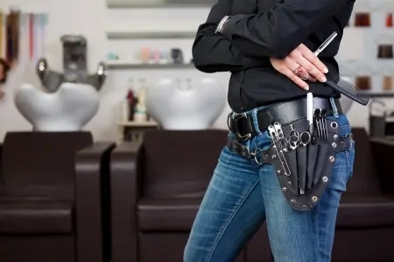
Year 2020. Competences/profiles/skills in the sector.
According to the National Association of Perfumery and Cosmetics (STANPA), there is a Salon each 900 citizens in Spain.
However 30% of hairdressers lose money every month.
This is the case of the low-cost models that emerged during the former crisis which offered hairdressing services that were performed by inexperienced people, encouraging intrusiveness, unfair competition and a B-economy .
Entrepreneurship

Slide 13
Year 2020. Competences/profiles/skills in the sector.
Digitalization
“Less than 25% of the salons are computerized,
more than 40% do not have active social networks,
more than 60% do not have a website,
more than 80% do not use any tool of online advertising,
more than 40% do not use any type of digital tool… ”.
(Sergi Moiset, director of SalonSolutions.io).

Slide 14
Year 2020. Competences/profiles/skills in the sector.
Sustainability
According Uala (the first telematic portal that includes the best hairdressing salons and beauty centers), in 2020, the offer of organic and environmentally friendly treatments increased by 20% compared to 2018.
The cosmetic international industry is reinforcing investigating in new natural produces instead of classic products related with petroleum and trying to use less plastic or recycled plastic to reduce the carbon foot print.
Some local Hairdressing Salons have began to work
on waste management

Slide 15
Year 2030. Competences/profiles/skills in the sector.

Slide 16
Phygital reality
Time efficiency
Natural health and welness
Customer´s demands

Slide 17
Specialitation and customer´s oriented
Hairdresser´s future skills
Eco friendly
Business oriented
Virtual marketing
Digital control of data and client´s preferences

Slide 18
Thank you for listenning

