Slide 1
Future skills for a better life in Sustainable Salons Introduction and Scope of the project
Milano/Pavia, Italy
Frank den Hartog

Slide 2
Agenda day 1: 061021
Day 1 – Wednesday October 6th, 2021:
09.30-10.00 hrs – Welcome with coffee
10.00-13.00 hrs – Introduction of partners, outlines and scope of the project (leader: Stivako)
13.00-14.00 hrs – Lunch (on site)
14.00-15.00 hrs – Administration and finance
15.00-16.00 hrs -- Introduction and tour CIOFS
16.00 16.30 hrs – The importance of dissemination and impact
16.30- 17.00 hrs—Questions on the project

Slide 3
Agenda day 2: 071021
Day 2 – Thursday October 7th, 2021:
09.30-10.30 hrs – Presentation per partner/country (max 10 min in PowerPoint) on the inventory/research (leader 4 schools)
10.30-12.00 hrs – Presentation Febelhair outcomes inventory/research on status education in EU and developments including discussion (leader Febelhair)
12.00-13.00 hrs – Presentation status future competences of a hairdresser and entrepreneur (leader Febelhair/Stivako)
13.00-14.00 Lunch
14.30-15.00 hrs – Workshop on management systems & certification (Stivako)
15.00-17.00 hrs – Status of the environmental certification system
Evening: social group dinner

Slide 4
Agenda day 3: 081021
Day 3 – Friday October 8th, 2021:
09.30-11.00 hrs – Student activities/program 3 student meetings including end multiplier event (leader 4 schools)
11.00-11.30 hrs – Discussing topics that we weren't able to cover at all yesterday and the day before
11.30-12.30 hrs – Activities in the coming period of all partners
12.30-13.00 hrs – Preparation next meeting
13.00-14.00 Lunch (if needed)
14.00-15.00 hrs – Individual coaching hour (if needed)

Slide 5
Stivako
Welcome to Stivako
Schiphol-Rijk, The Netherlands
Vocational Training and Education Institute for management and Leadership in the print media and creative industries
75 years of education of entrepreneurs
Focus on management and marketing
Sustainability and CSR
Innovation

Slide 6
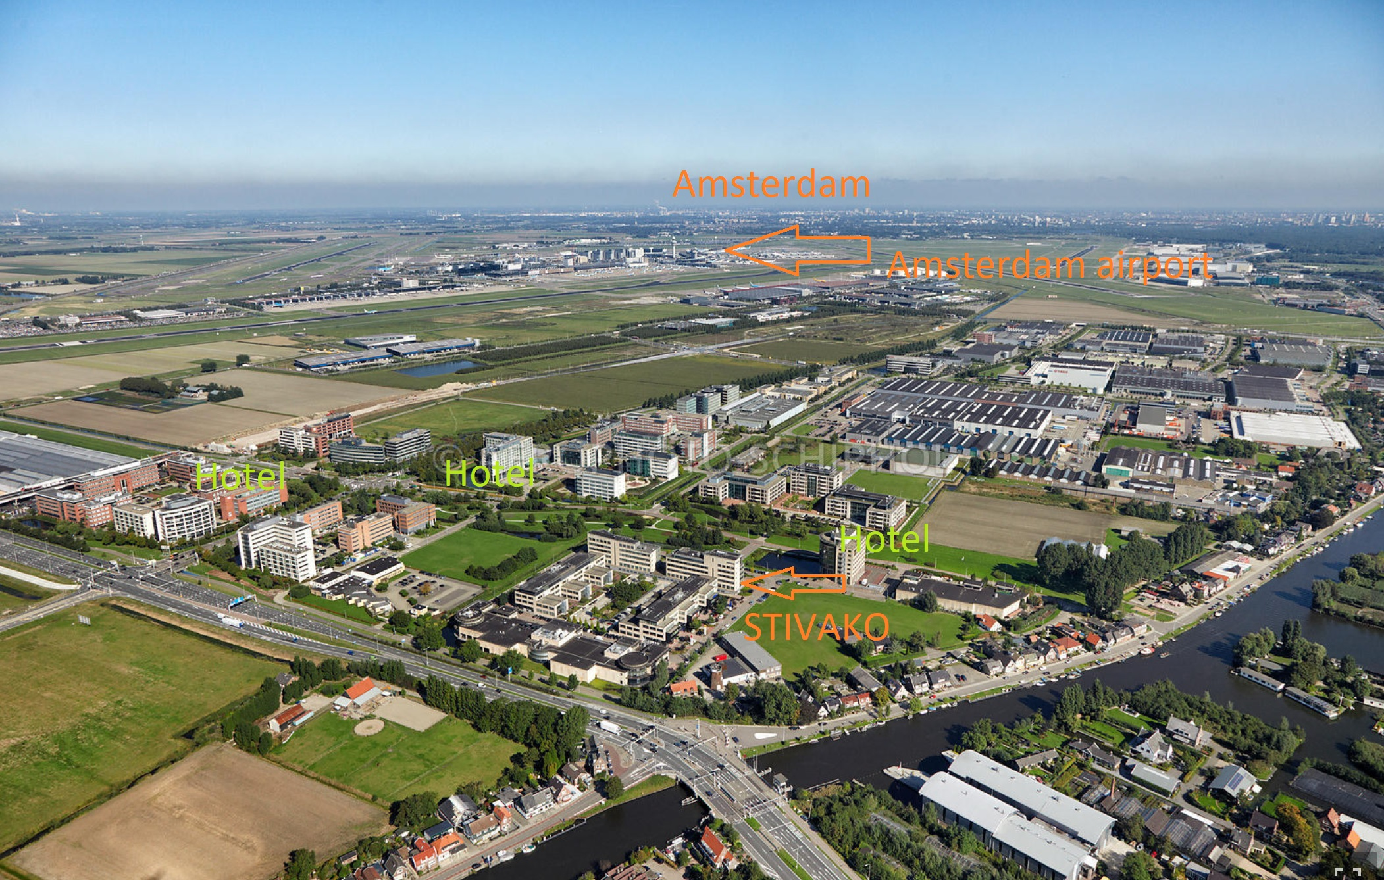
Stivako

Slide 7
Activities Stivako
Education: VET; incompany, parttime
Workshops
Training activities
Coaching on innovation
Sustainability: quality, health & safety, environment, CSR, FSC
Sales & marketing, leadership, HRM, coaching, finance, management etc.
Focus:
Creative industries esp. Graphic media industry, in NL 1250 SME’s
Amount of teachers: 25 (flexible employable)
Amount of students: average 750 a year
Average age of students: 20 – 50 years old

Slide 8
How in Stivako
Strong focussed on company practice with ‘real life’ assignments and games that have to contribute to the competitiveness of the company.
Focus on the job profiles needed in the future (‘new skills for new jobs’)
Focus on the new aspects of company management.
Innovation with products; for example: Accountmanager of the future, Sustainable employability, Entrepreneurship SIGN and Printmedia
Coaching companies in innovation processes
Research and projects to stimulate innovation and change.

Slide 9
Website Stivako
https://www.stivako.nl

Slide 10
Rationale
In the project we gather facts through an inventory of the hairdresser's competencies in 2030, the desired situation in a sustainable salon focus on environmental aspects (core of a simple standard), competences needed to reach this situation and research on two diagnostic self-assessment tools to map the current situation on:
1. competence level and measuring the gap on profile and future competences and
2. the gap of the level towards the sustainability system on environment and sustainability in schools (salon).
The outcomes of the inventory we will discuss with experts and the results are later on the input for developing the self-assessment tools, the learning material on environment in a sustainable salon and awareness material on sustainability.
See page 81 of the submitted project proposal

Slide 11
Outputs
O1 Profile / competences of the hairdresser in 2030
Output Type Studies / analysis – Research study / report
02 Sustainability standard for schools and the sector
Output Type Methodologies / guidelines – Certification system
03 Digital instrument: diagnostic self-assessment tool
Output Type Open / online / digital education – Other
04 Learning material on sustainability in the Hair & Beauty sector
Output Type Learning / teaching / training material – Manual / handbook / guidance material
05 Physical awareness tools
Output Type Learning / teaching / training material – Toolkit
Multiplier event 1 and 2
Train the trainer activity
See page 83 of the submitted project proposal

Slide 12
Participants I
1. Inventory of the hairdresser's competencies in 2030: - Per country 2 schools/partner, per schools/partner 4 persons = 32 persons, - Contact with organizations on management systems 4 per country = 16 persons;
2. Expert meetings: - Per country 1 school/partner, per school/partner including preparation 5 persons = 20 persons.
3. Development of a “low threshold” standard for a sustainability label for the sector: participation of experts: minimum 4 experts will be involved. Other: - Contact organisations on management systems 4 per partner country = 16 persons
4. Research and development on self-assessment tools: (1: Gap analyses, focusses on the gap in competences between the present level of competences and the future competences and 2. Classification sustainability, will provide a classification of the status of a salon (in the school or as a company) regarding the level of sustainability) in 4 languages development in the hair and beauty sector = 12 persons in partner countries; - Per country 2 schools/partner, per schools/partner 4 persons = 32 persons.
5. Development Learning material on sustainability/environment in the Hair & Beauty sector: - per developing partner = 20 persons; - participation of experts/entrepreneurs =12 persons

Slide 13
Participants II
6. Validation and adjusting of learning materials: - 5 persons per country = 20
7. Developing the awareness material final results): -About 10 persons across the partner countries. -participating students per school 4 persons = 16
8. Testing and validation of the self-assessment tools: per country 10 persons = 40
9. Testing of modules for sustainability learning materials including Train the trainer: In school testing =100 persons (4 countries, 25 per school/country)
10. Final Sector Conference and Student participation: In addition to the last work conference of the partners, a final sector conference will be organized in Italy = 75 participants.
During the project, student participation will take place at 3 work conferences and the sector conference. 16 students per activity
The amount of persons that will benefit indirectly from the project will amount to approximately 290: VET teachers, VET students, salon owners / managers, Salon employees, Experts In the various stages of the project.
All participants will be involved in a number of activities: 1. Awareness raising 2. Needs analysis 3. Content development 4. Validation
See page 93 of the submitted project proposal

Slide 14
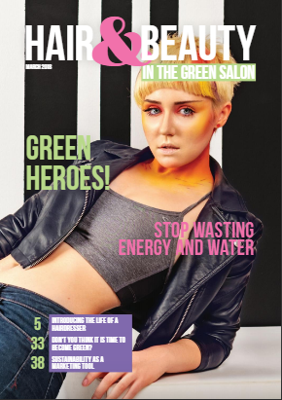
Student activities
Student participation will take place at 3 work conferences and the sector conference.
During these meetings the students from the partner countries get 3 major assignments:
Pretesting the developed materials
Developing the content and design of a magazine.
Development of an awareness package for the hairdressers with stickers about the practical interpretation of the environment.
https://issuu.com/hartog236/docs/glossy_hair_beauty_2018_digi/10

Slide 15
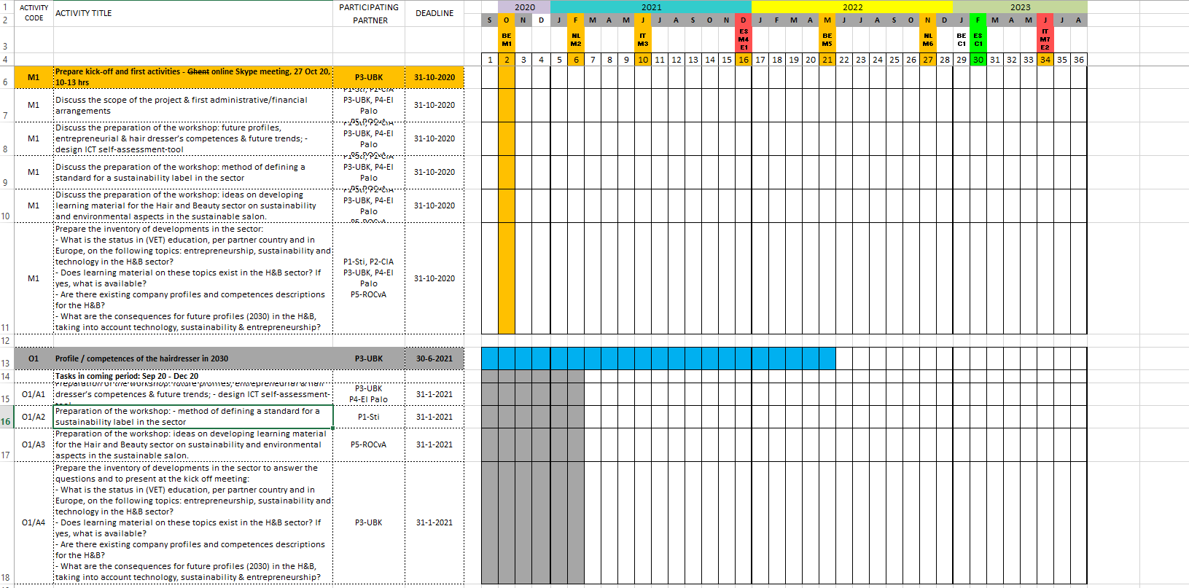
Planning
Click to make text

Slide 16
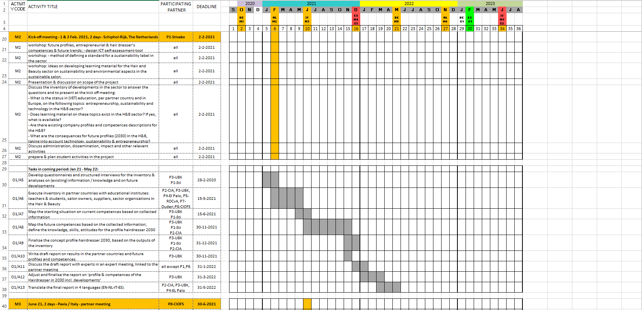
Click to make header
Click to make text

Slide 17
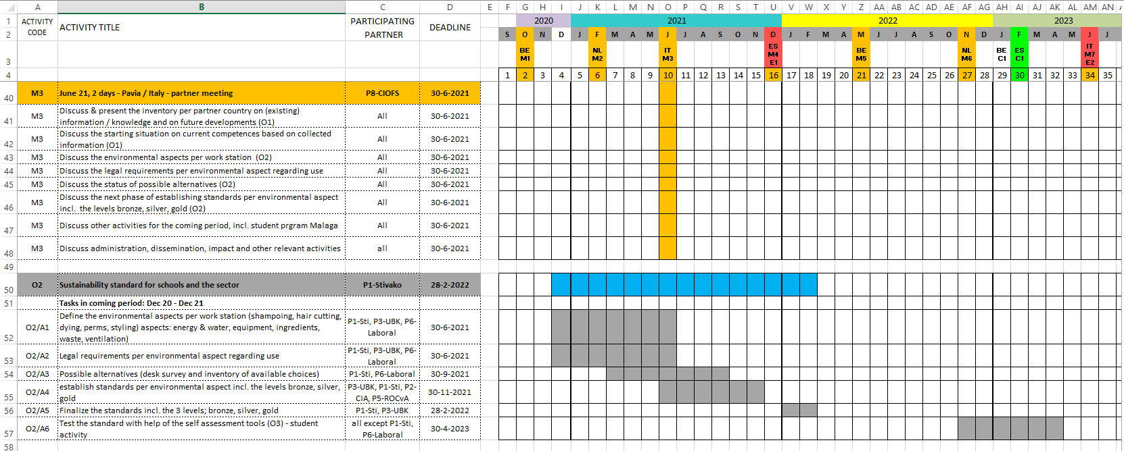
Click to make header
Click to make text

Slide 18
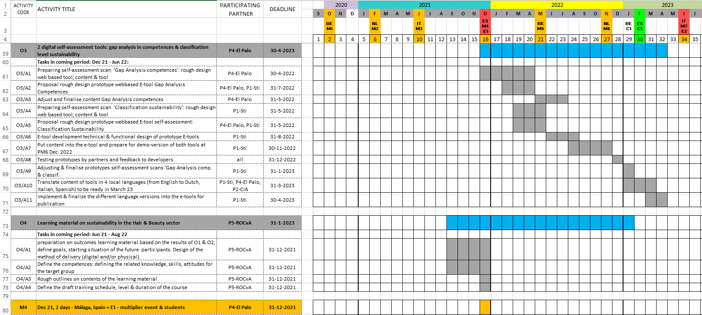
Click to make header
Click to make text

Slide 19
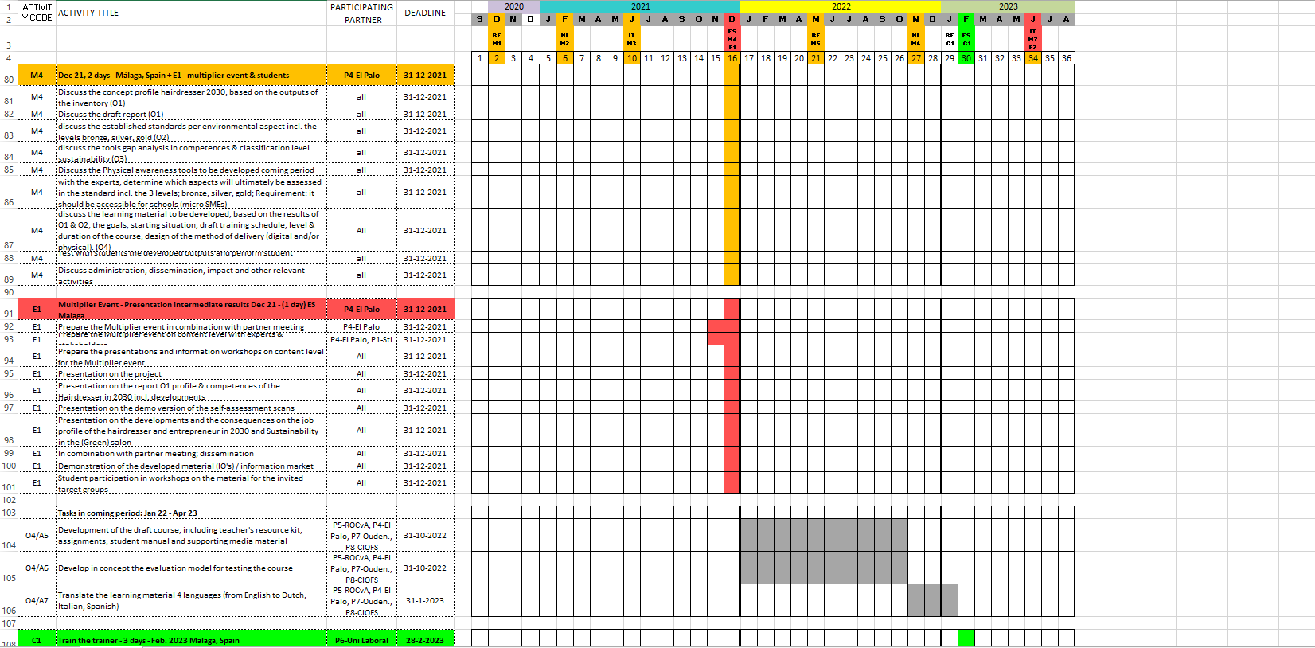
Click to make header
Click to make text

Slide 20
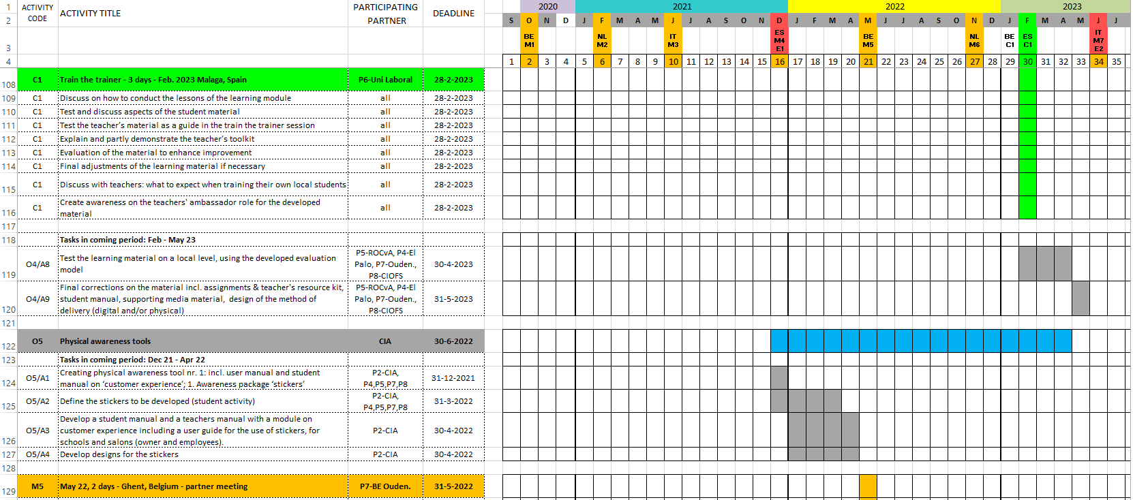
Click to make header
Click to make text

Slide 21
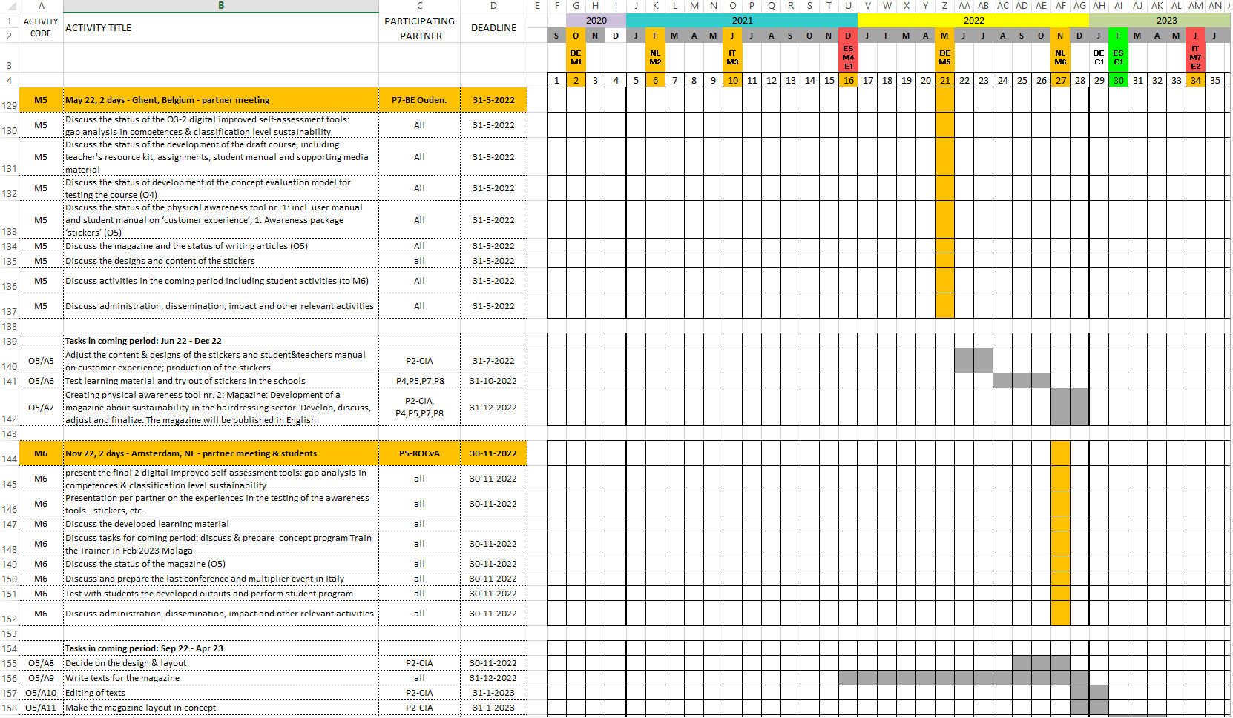
Click to make header
Click to make text

Slide 22
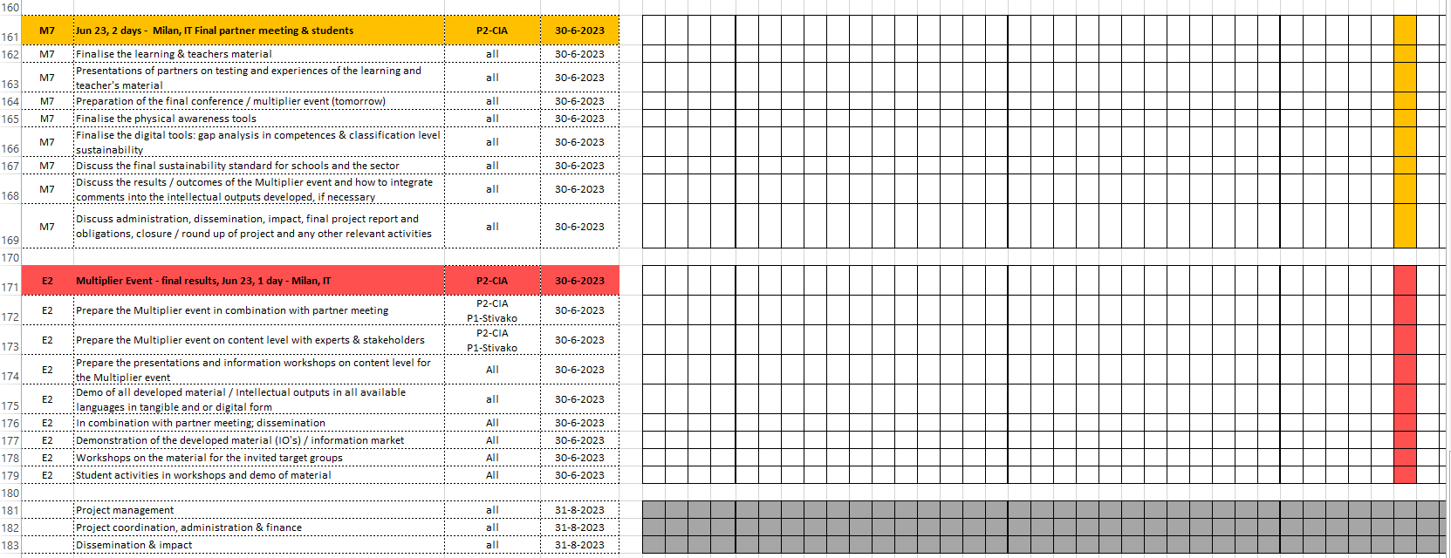
Click to make header
Click to make text

Slide 23
Questions/remarks

