Slide 1
PODCAST ABOUT
SUSTENIBILITY
By David
Diego
Valentina
Alessia
Katherin

Slide 2
How to make a PODCAST?
We Made a podcast using microphones, headphones and a console with commands. We ansueder the questions that were asked about sustenibily, and about our experience in AMSTERDAM and this Shool

Slide 3
Our EXPERIENCES WITH THIS PROJECT
Questions:
What do you think about sustainability?
What are the difference in sustenibily between Italy and Amsterdam?
What can be done to increase sustenibily?
How to make the hair dye more sustainable?
What do you think about products testing on animals?

Slide 4
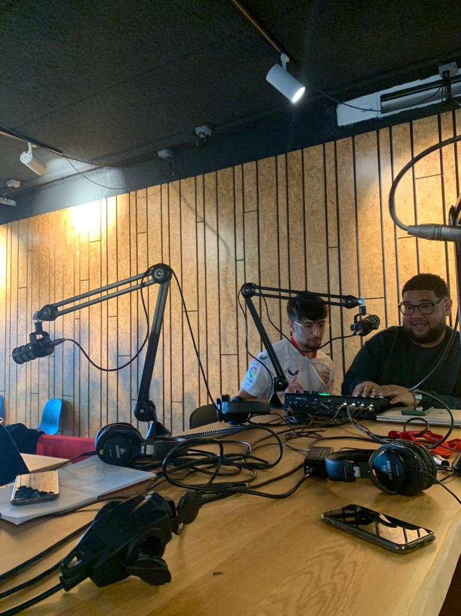
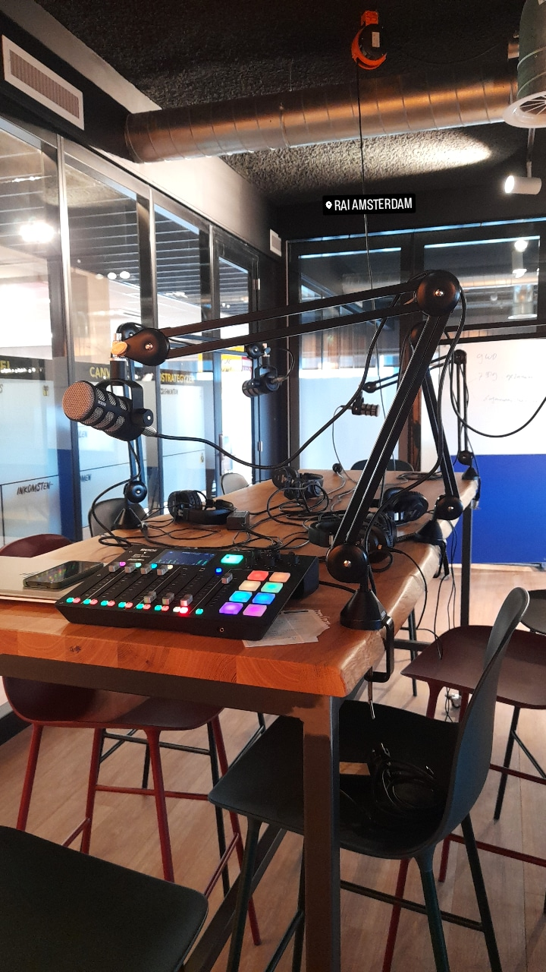

Slide 5
We think the sustainability is so important for the environment and for the reason we were happy to address this topic. The sustainability in Amsterdam is so different between Italy because example:
• in Amsterdam bikes are used a lot so the pollution is less.
• In Amsterdam pay more attention to separate collection.
•They pay more attention to water consumption
Our answer

